Slide 1
St John's Church of England Primary & Nursery School
an academy in The Good Shepherd Trust
School Newsletter
Spring 2 2024
In harmony we
Nurture, Inspire, Flourish
The St John’s Primary Admission policy 2024/25 and respective documentation has been determined and is available on the school website
https://www.stjohnsdorking.uk/admissions
Spring Term One
Easter
Value: Resilience
With a rather soggy start to Spring, it is with great joy that we see the sun peaking through, spring flowers blooming and our love of nature captured down on Jolly John’s.
Ducklings were born in Reception, and we had trips to The Discovery Centre, Squires Garden Centre to plant potatoes, Eco Day at Guildford Cathedral and Chartwell to name but a few. Year 4 were outstanding in representing St John’s on their PGL residential with lots of teamwork involved and we have taken part in The Big School Clean Up - collecting litter for Eco Council.
We have had an opportunity to learn and build our understanding of multicultural authors in our book week, not to mention the creation of a whole school book and author workshops across the school, the chance to see a magical performance of Alice in Wonderland by M&M Theatre Productions and finally share a beautiful Easter journey with our Easter walk. The Pupil Parliament and our very own children wanted to raise money for refugees and our amphitheatre floor. Thank you to all who joined us.
A final well done to Year 3 who led our poignant Easter service. Thank you for all your support and to the Friends who have raised funds with a cake sale, disco and second hand uniform. Have a wonderful Easter holidays and let us reflect on Psalm 100 O BE joyful in the Lord, all ye lands : serve the Lord with gladness, and come before his presence with a song.
Jacky Fyson
Executive Headteacher
Below is a couple of links you might like to try with your child before or after school, or maybe before bedtime to help and support them to regulate. There are many others online that you can link to your child's interests. (dinosaurs,cats, dogs and favourite books).
https://www.youtube.com/watch?v=29DQJWGwEnY
https://www.youtube.com/watch?v=j9YlWqcQjwQ
St John's CofE Primary School, Goodwyns Road, Dorking, Surrey, RH4 2LR

Slide 2
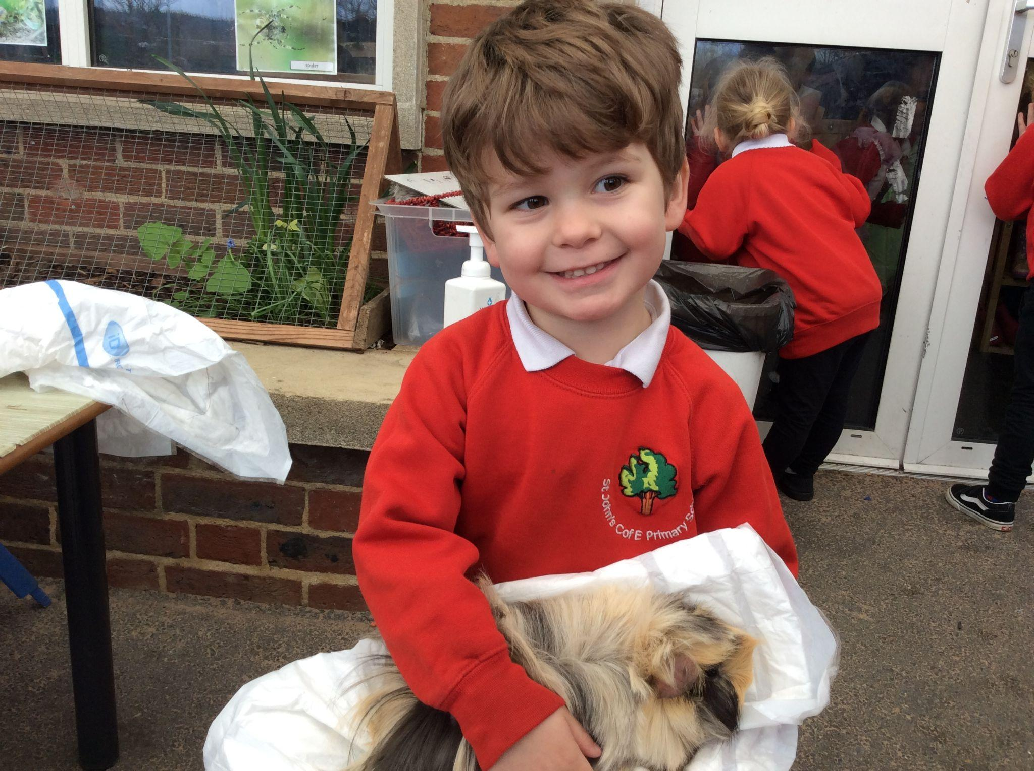
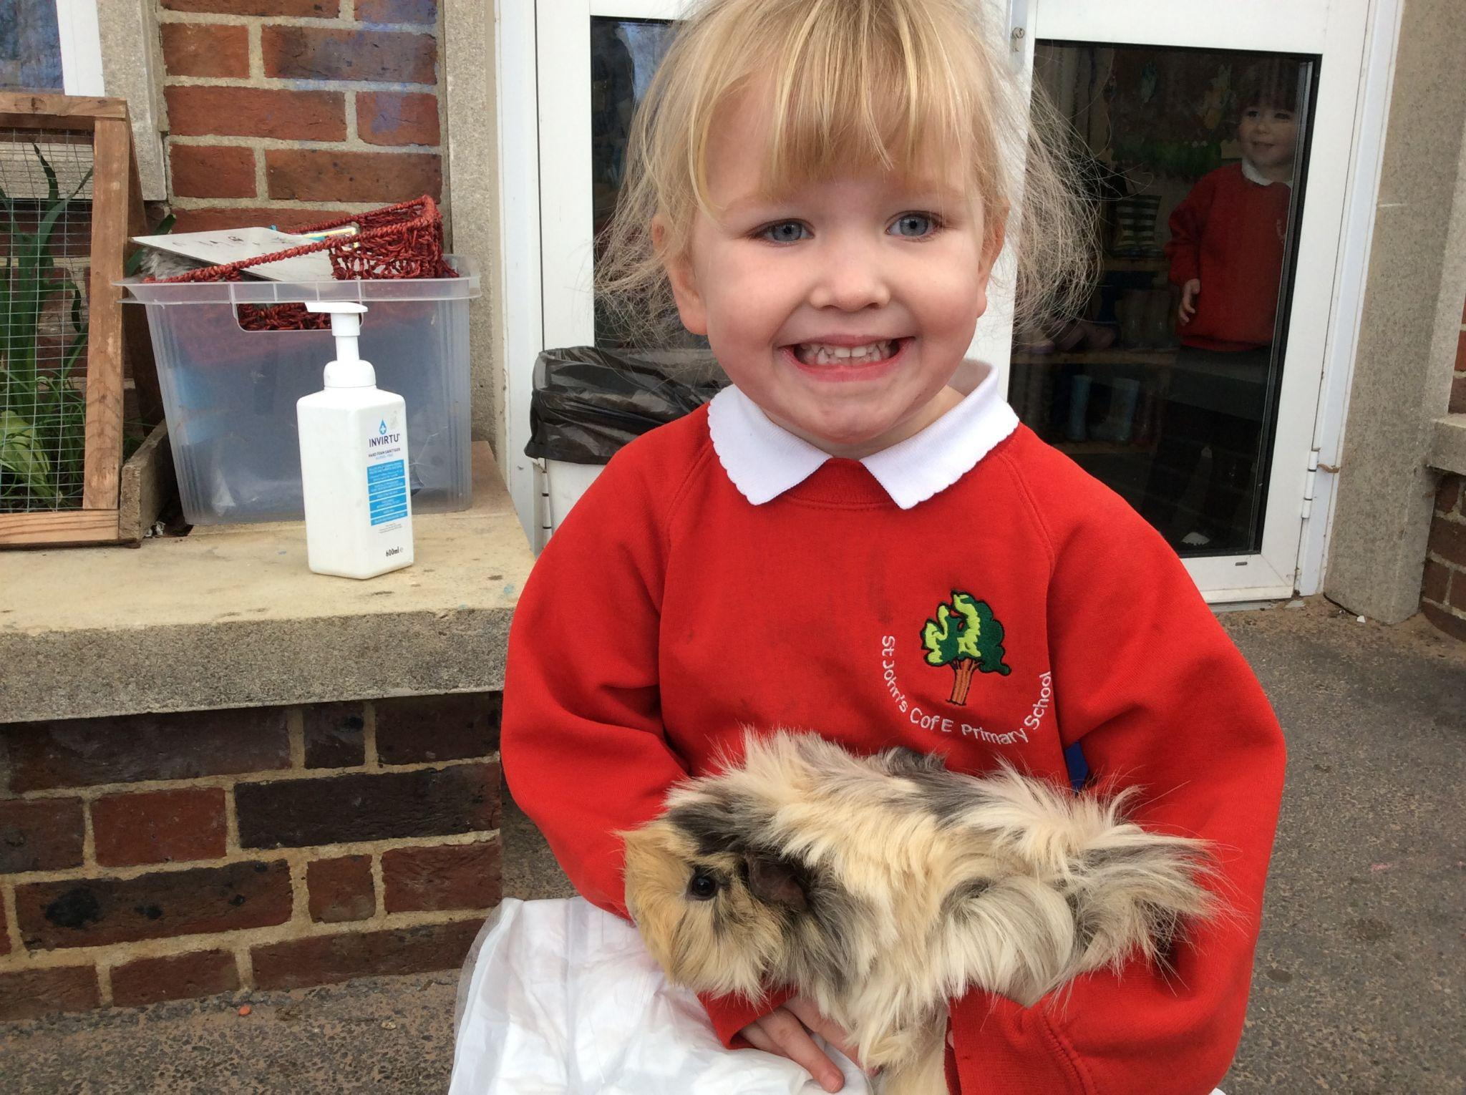
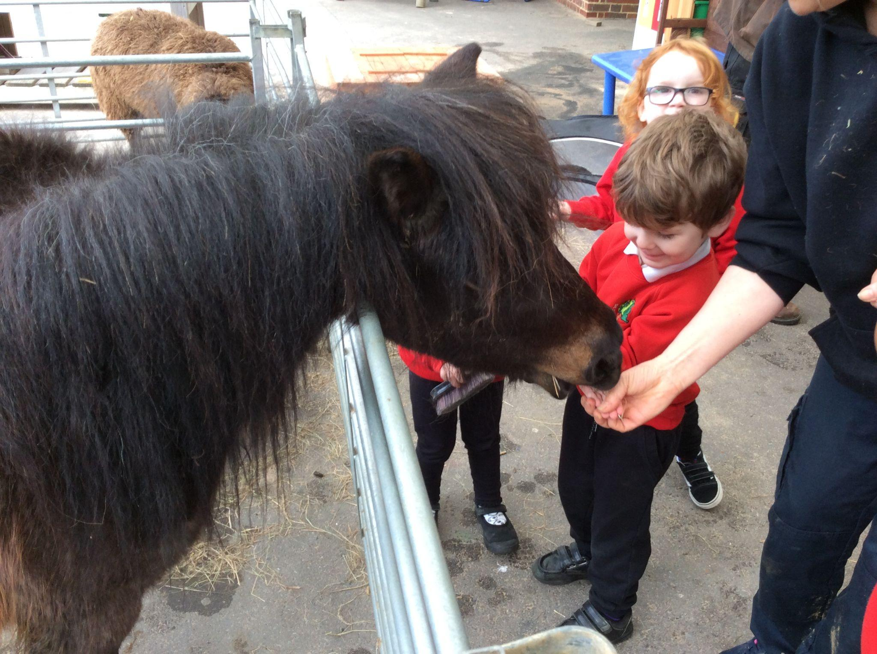
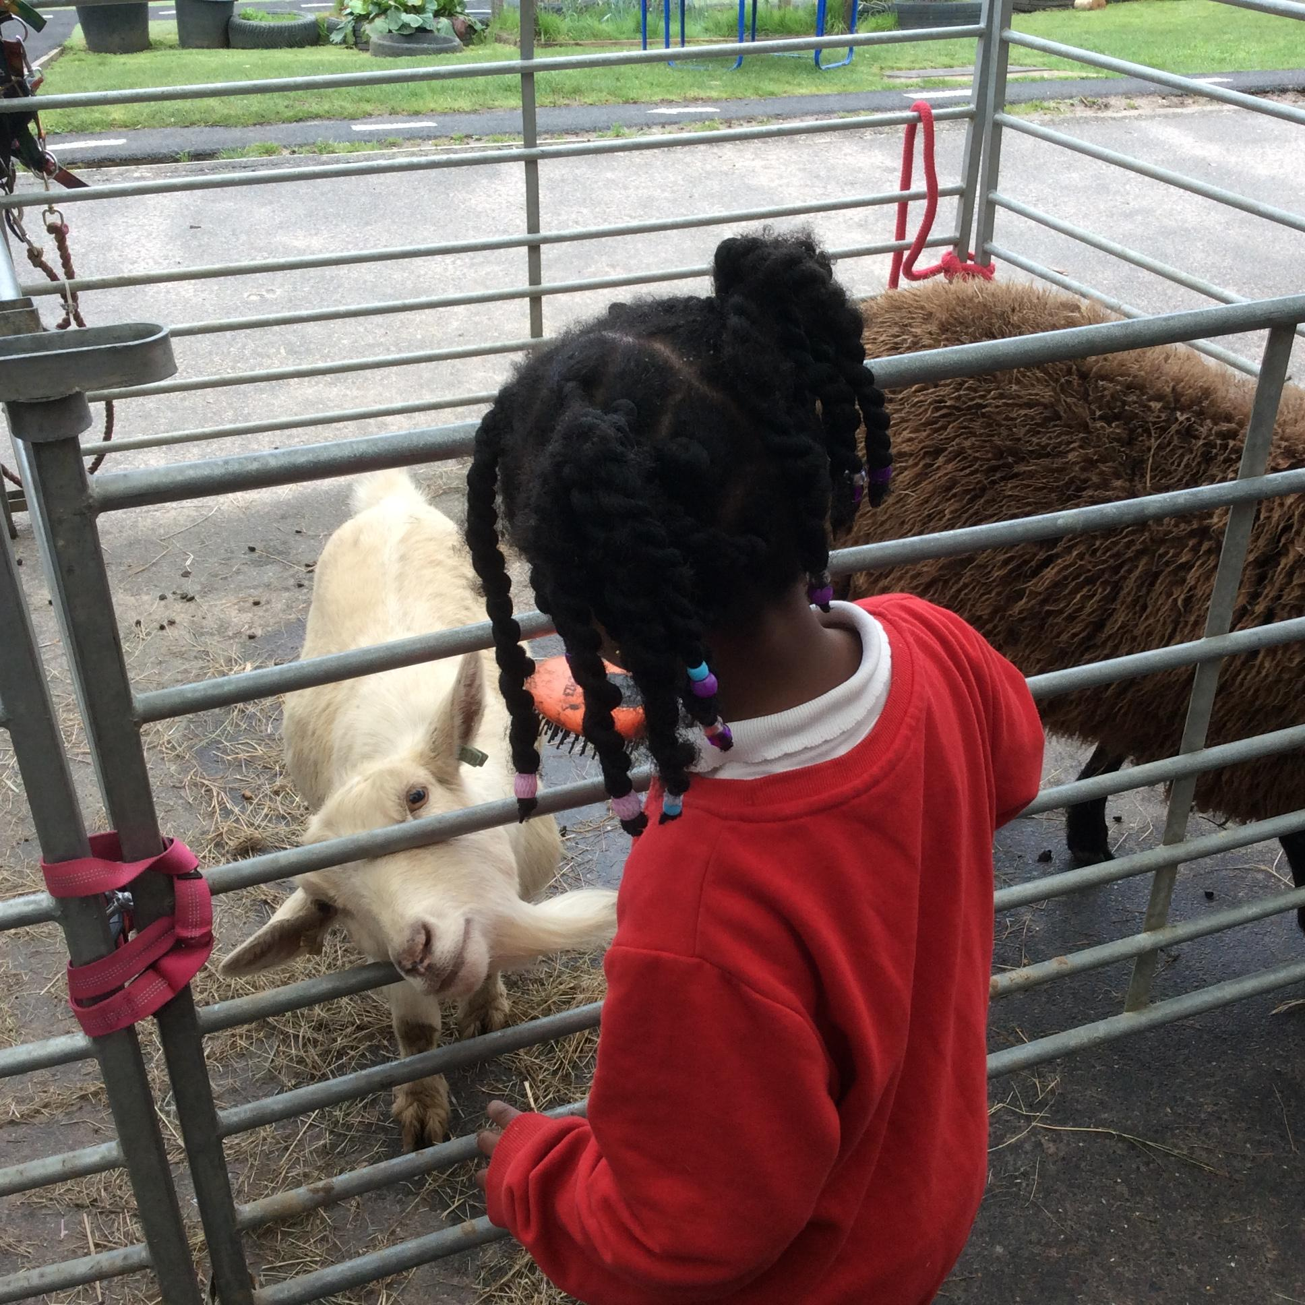
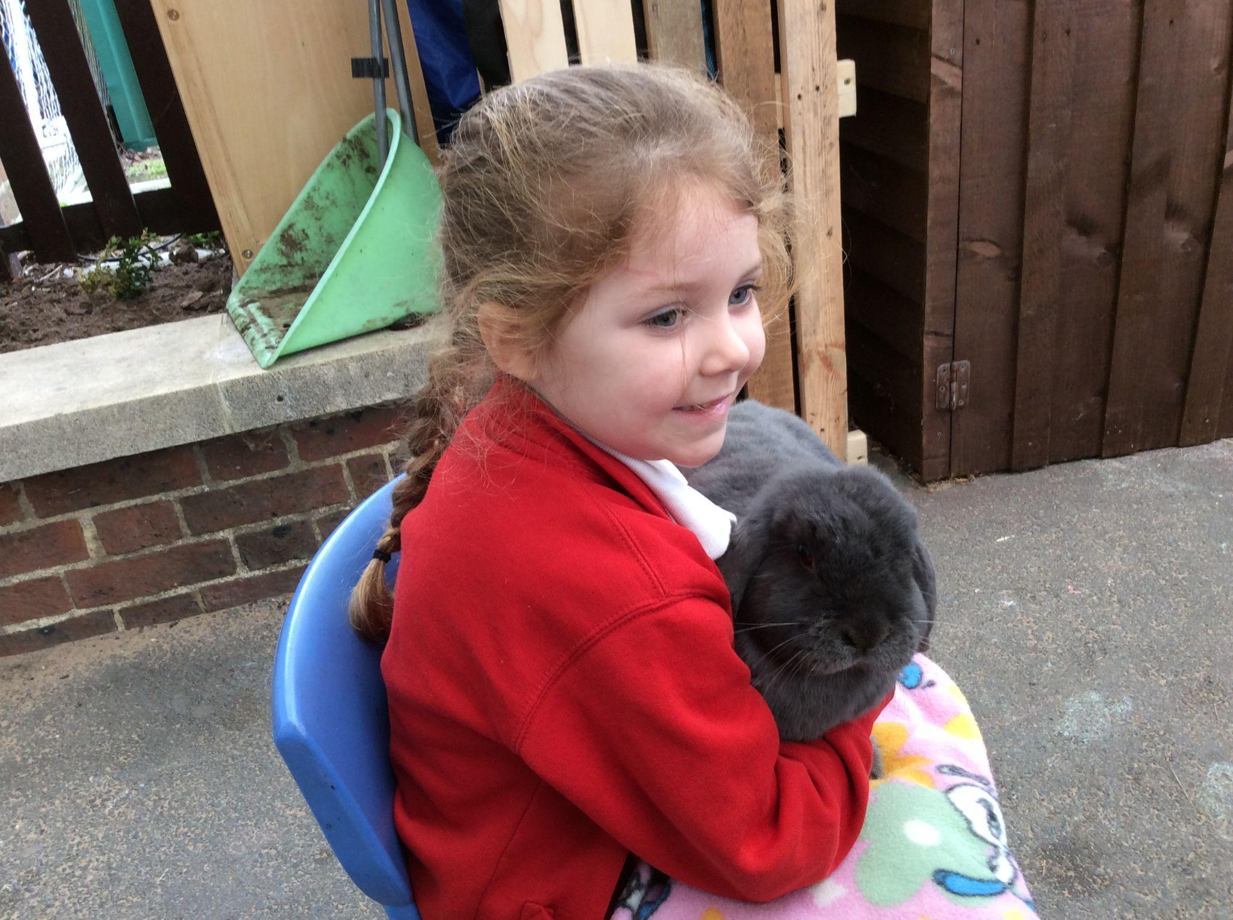
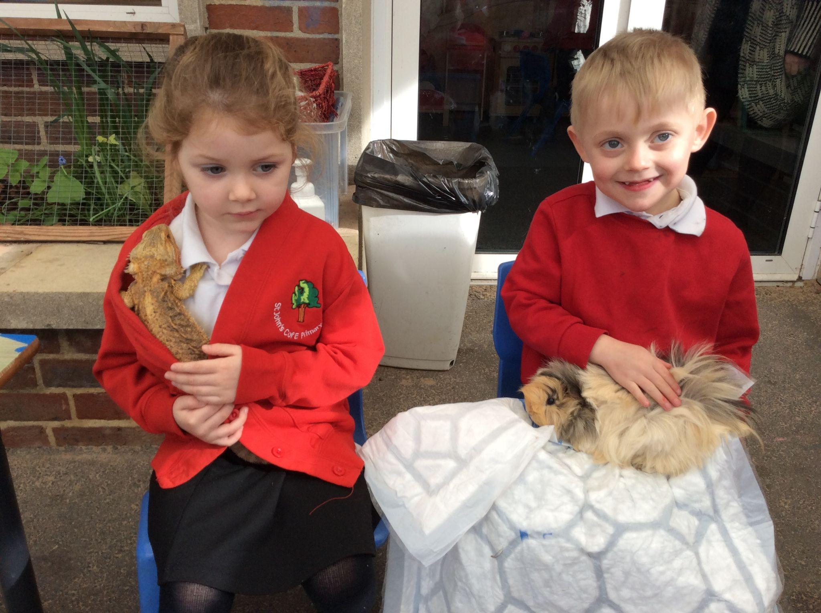
Nursery Happiness Class
This week Nursery were delighted to welcome Manor Farm into our school where the children were able to have hands-on experience with the animals. Many enjoyed stroking, feeding and cuddling the furry ones, along with putting glitter on the Shetland ponies!
The experience helped prepare the children for our Bocketts Farm trip later in the year and discussion on our topic of cycle and offsprings.
St John's CofE Primary School, Goodwyns Road, Dorking, Surrey, RH4 2LR

Slide 3
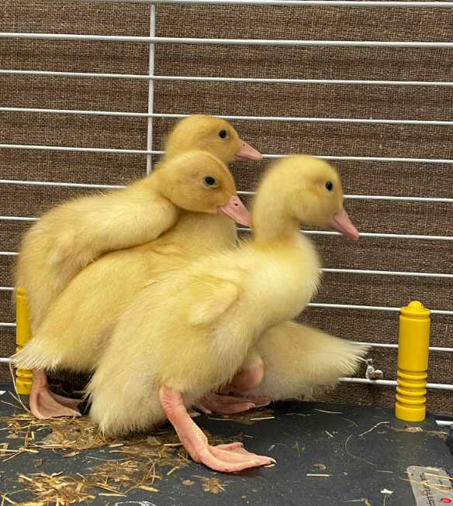
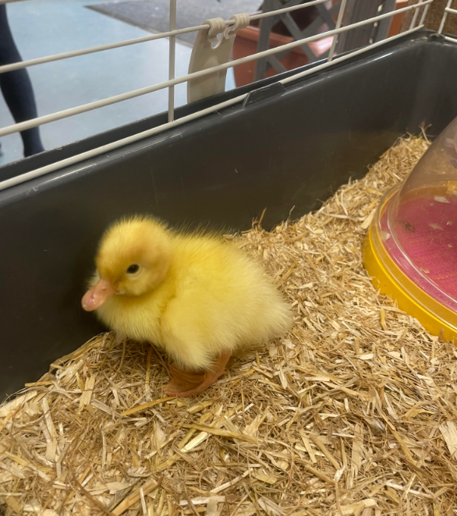
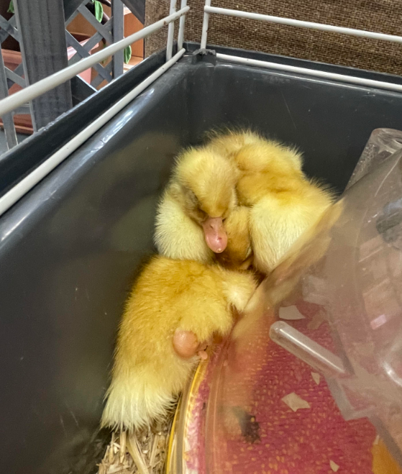
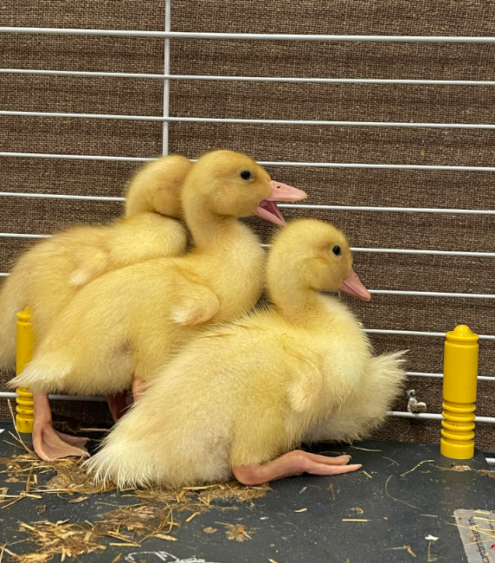
Reception Kindness Class
Reception were so excited to receive some eggs in an incubator. We watched the eggs hatch into ducklings over two weeks.
The ducklings will be supporting our learning on the harmony principle of cycles in nature and the life cycle of plants an animals.
St John's CofE Primary School, Goodwyns Road, Dorking, Surrey, RH4 2LR

Slide 4
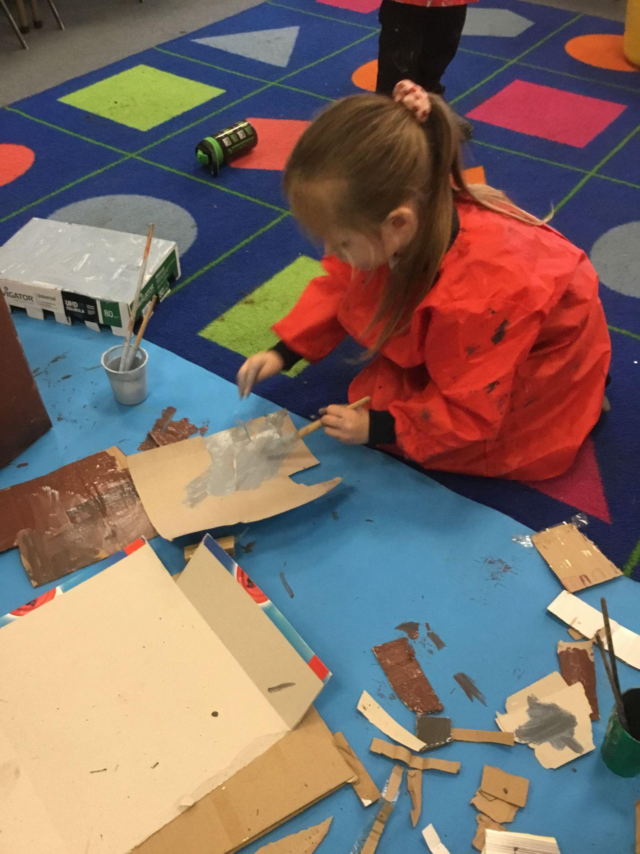
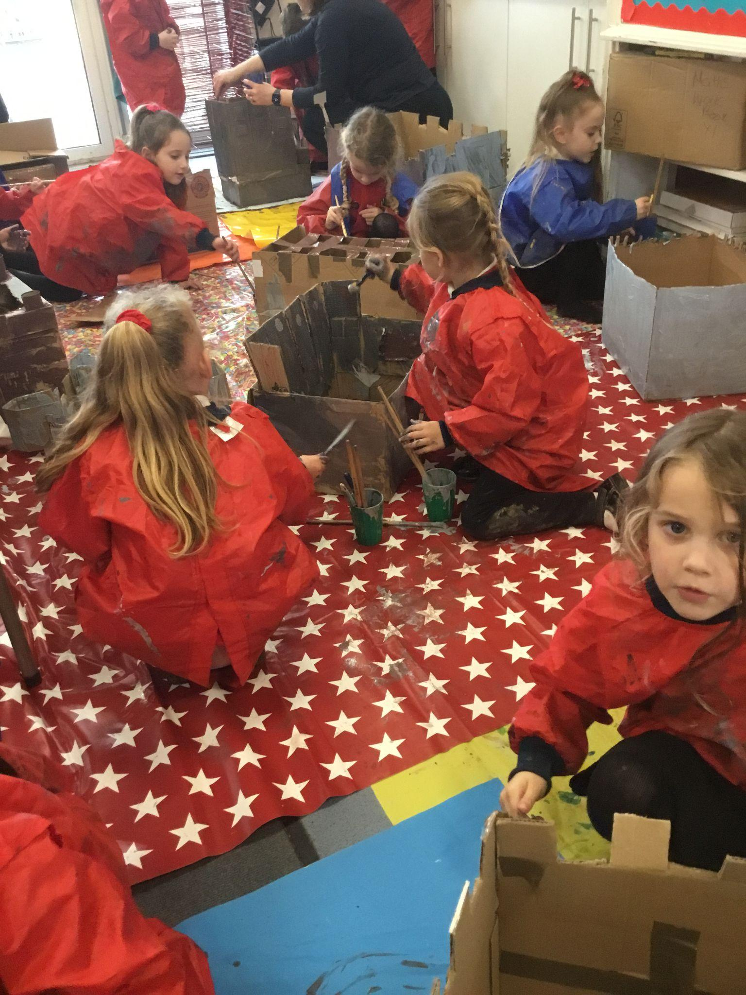
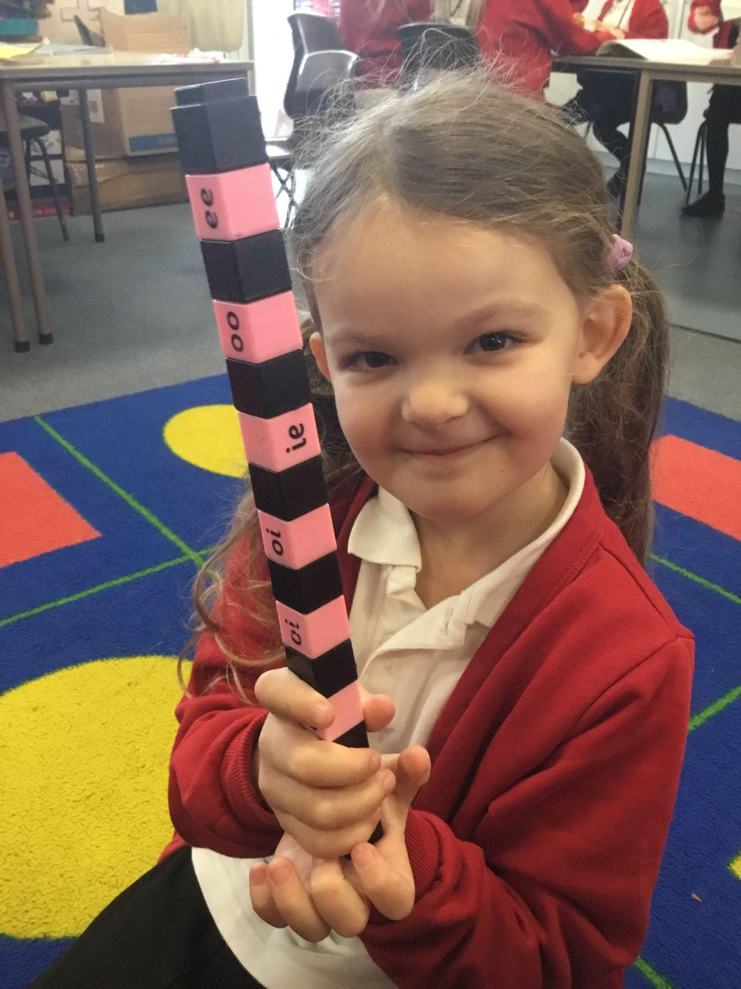
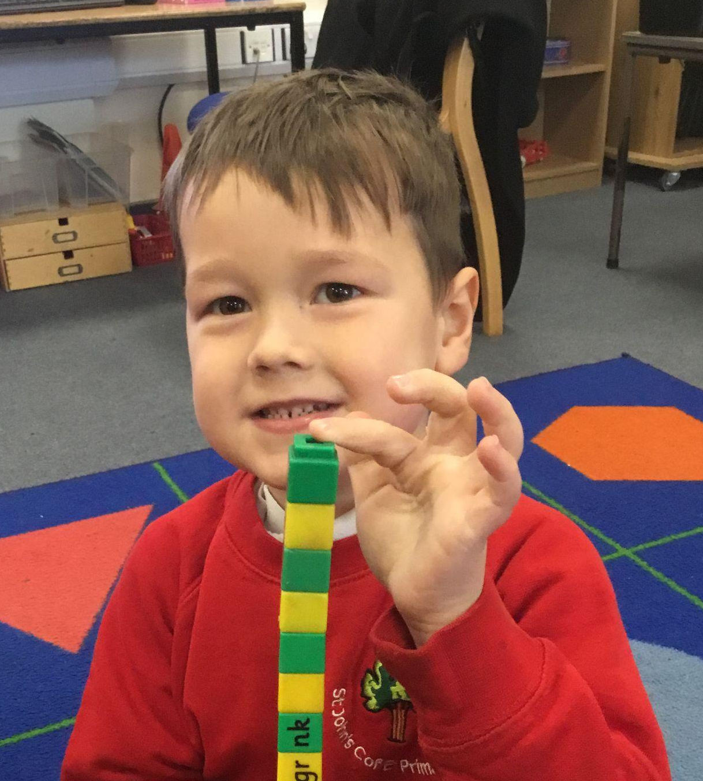
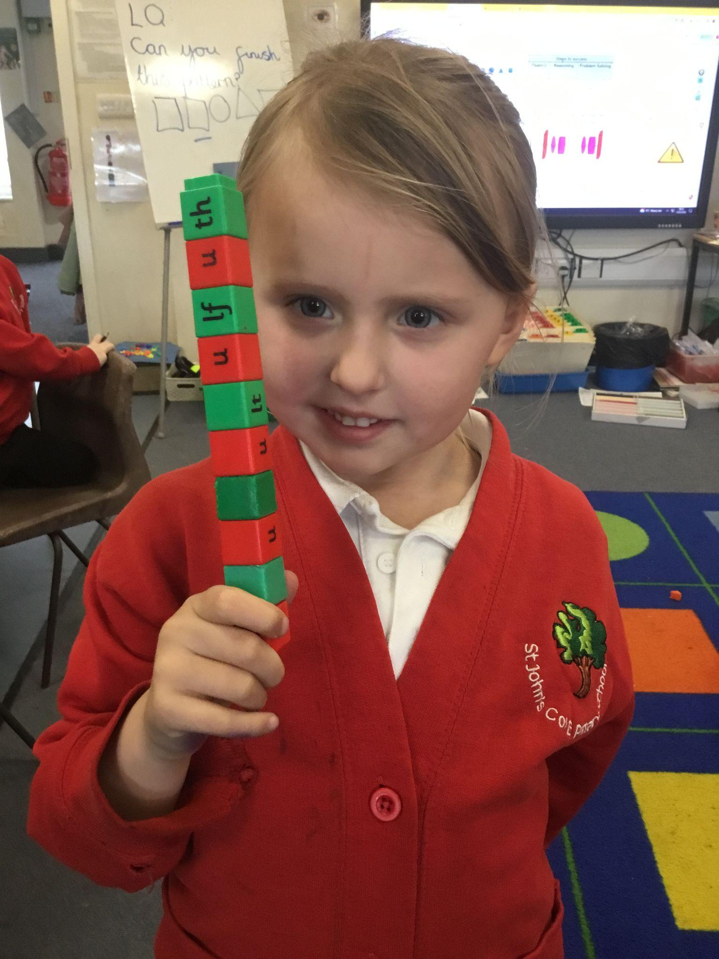
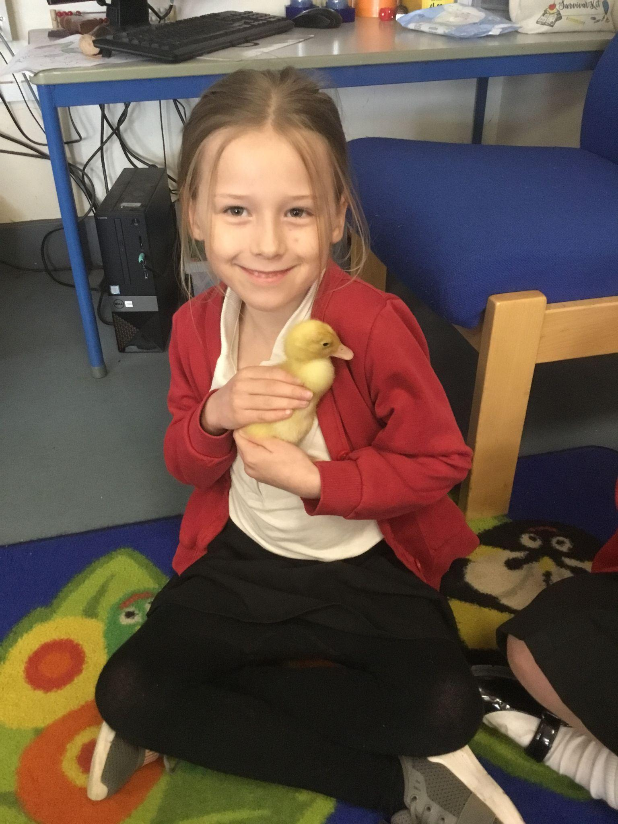
Year 1 Love Class
In D.T. this term our topic was based around Castles. We evaluated toy castles, explored, designed, made and decorated our own out of junk modelling. We had so much fun adding details such as a drawbridge, arrow slits, battlements, portcullis and flags.
We are looking forward to applying our new learning on our school trip to Hever Castle!
In Maths, we have been learning about shape and pattern. We made our own repeating patterns using the cubes and counters.
We were lucky enough to pay a visit to the duckling’s one afternoon! These lovely ducklings have been growing in the Reception class for the last week, we loved observing and interacting with them.
St John's CofE Primary School, Goodwyns Road, Dorking, Surrey, RH4 2LR

Slide 5
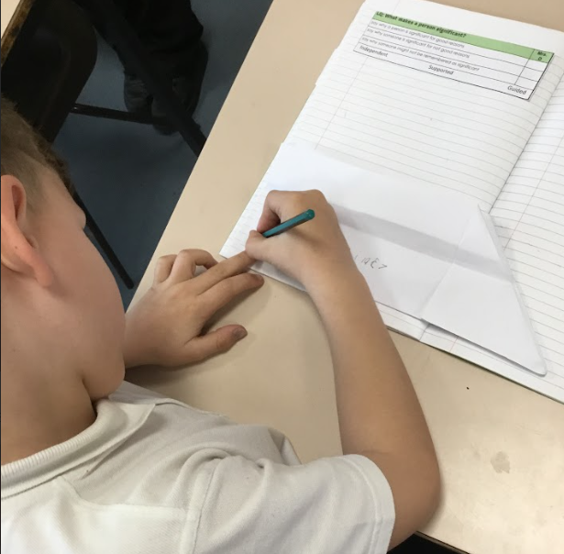
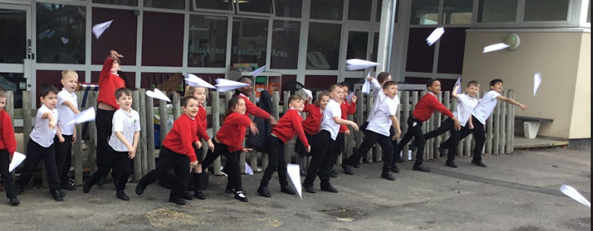
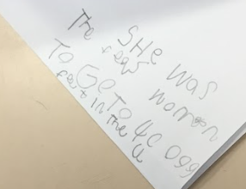
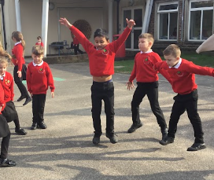
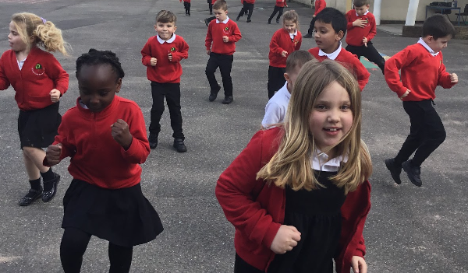
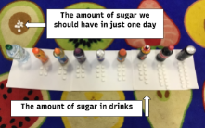
Year 2 Trust Class
What an amazing time Year 2 have had learning this term! They have been to the Discovery centre where there was much hilarity over distorting mirrors and excitement about making different sounds, jumping on a big piano, making shadows and trying to keep a disc on a turntable.
They have learnt facts about significant people including Amy Johnson and Neil Armstrong. The facts they learnt about Amelia Earhart were written on a paper plane and then they got to fly them in the playground!
The children have investigated how exercise impacts the body. It was a lovely lesson outside so we could run, walk, skip and also complete ‘spotty dogs’.
They have looked at how much sugar is in drinks and discussed which is the healthiest option.
The children have completed their first story map (rather than a story mountain) and written
their own story based on George and the Dragon. RE day saw them learning about and
retelling the Easter story all ready for our annual Easter walk on Thursday.
St John's CofE Primary School, Goodwyns Road, Dorking, Surrey, RH4 2LR

Slide 6
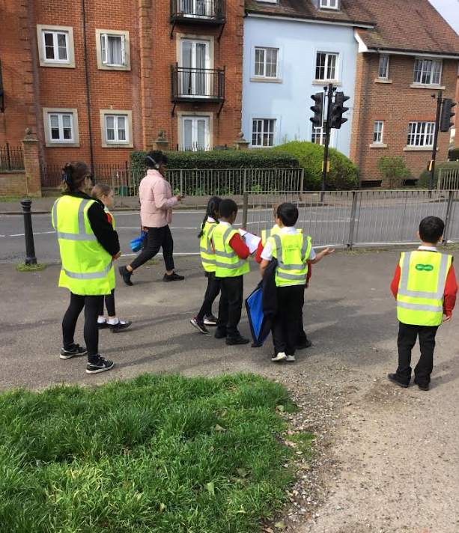
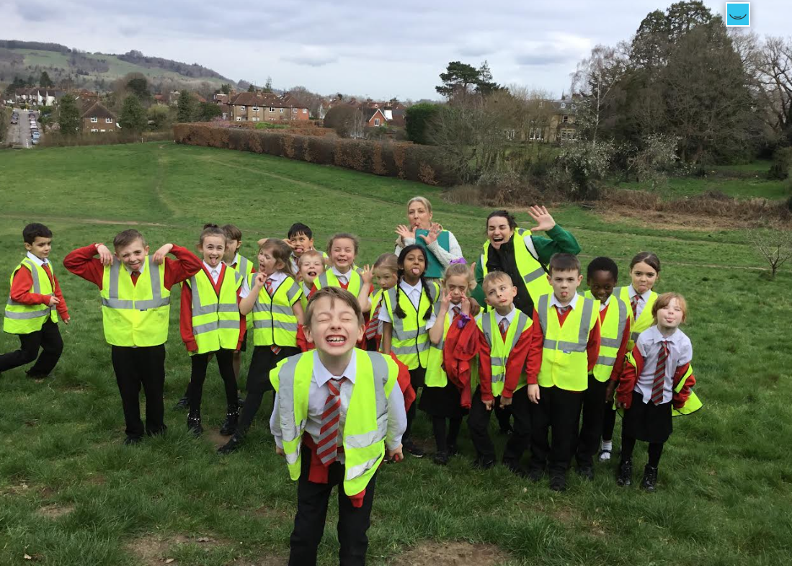
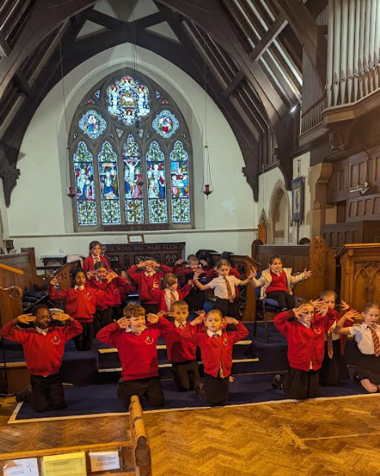
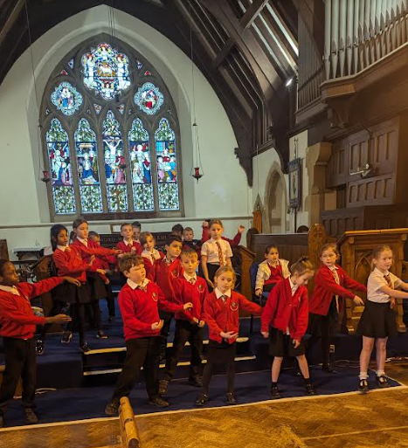
We’ve had a busy term in Year 3 - finishing our learning about the Romans, learning all about
Forces and magnets, starting our geography unit on improving our local area and of course,
getting ready for our Easter service at the end of term!
Here we are doing a traffic survey to see how people travel around Dorking. We followed the
route we planned and noted the human and physical features that we saw. We finished by
enjoying a break on the Nower!
Year 3 Cooperation Class
Here we are practising for our Easter service at St John’s Church. We’ve worked hard to learn our lines and songs. We’ve even learnt a dance and sign language to one of the songs.
We look forward to showing it to you!
St John's CofE Primary School, Goodwyns Road, Dorking, Surrey, RH4 2LR

Slide 7
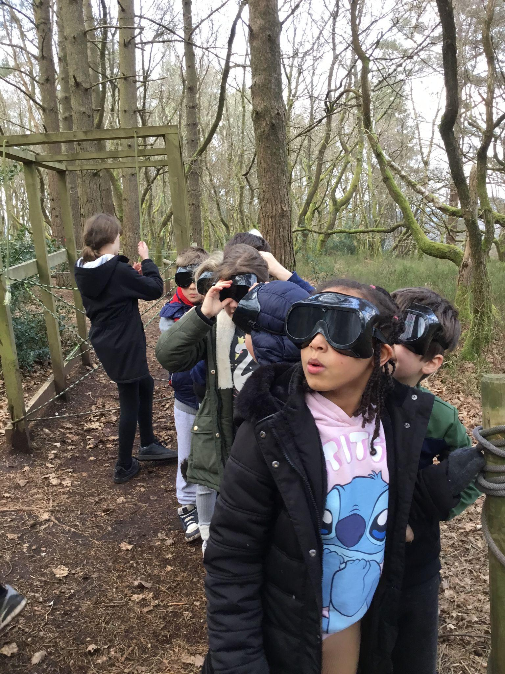
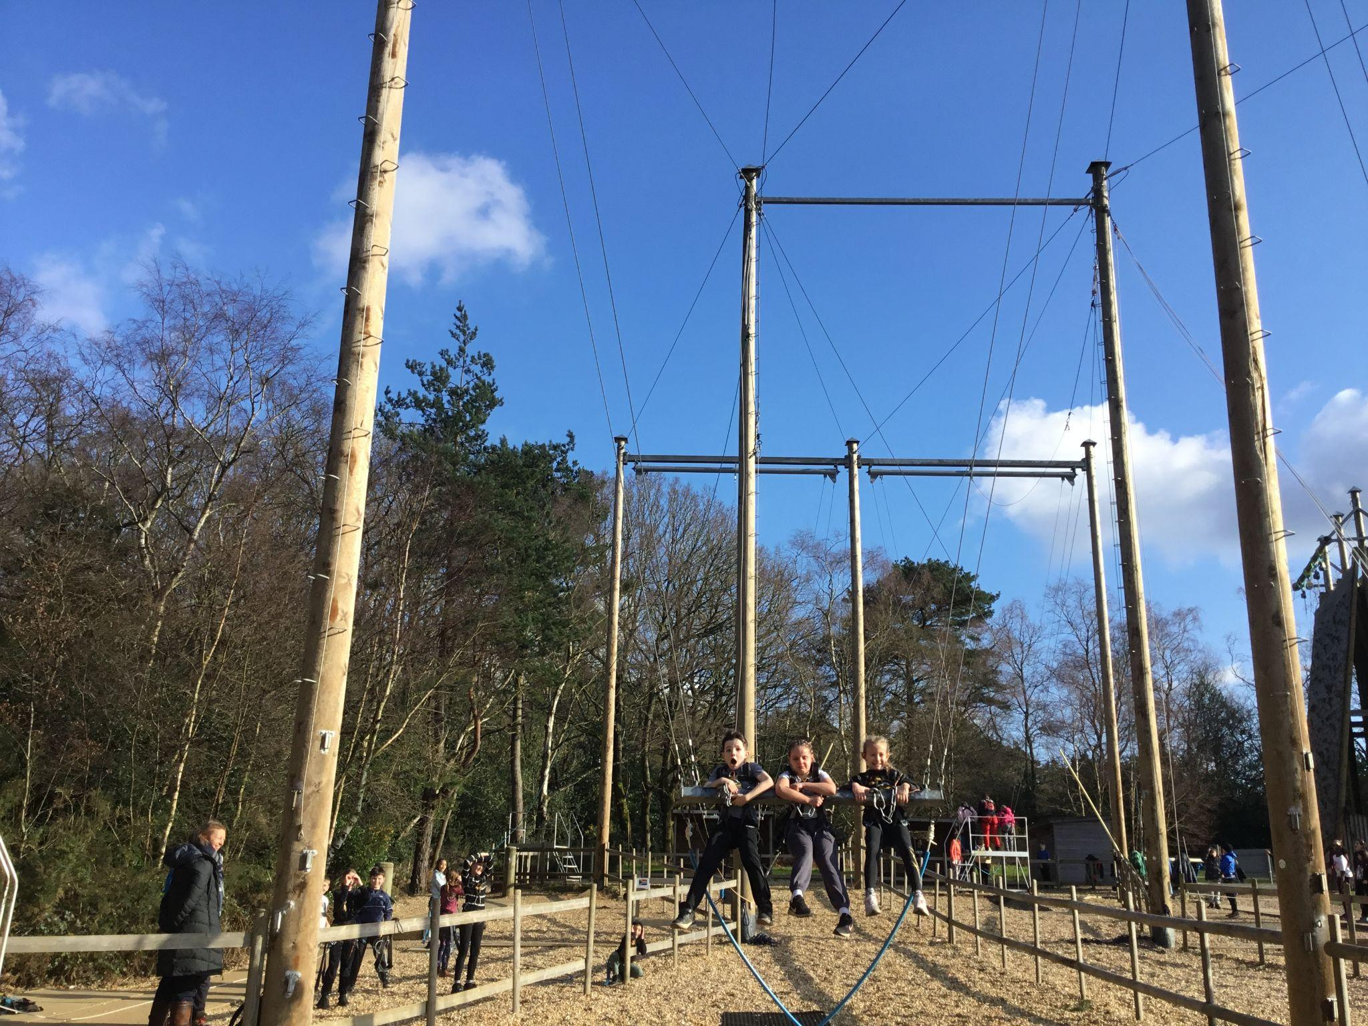
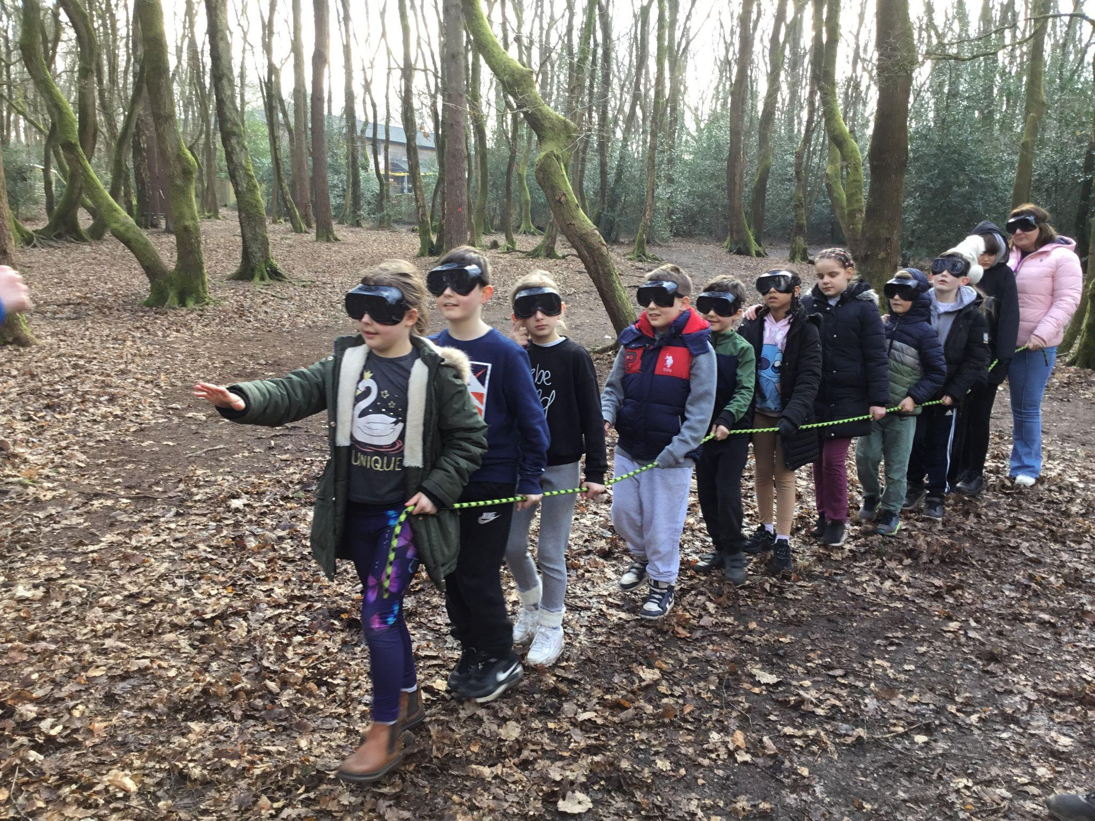
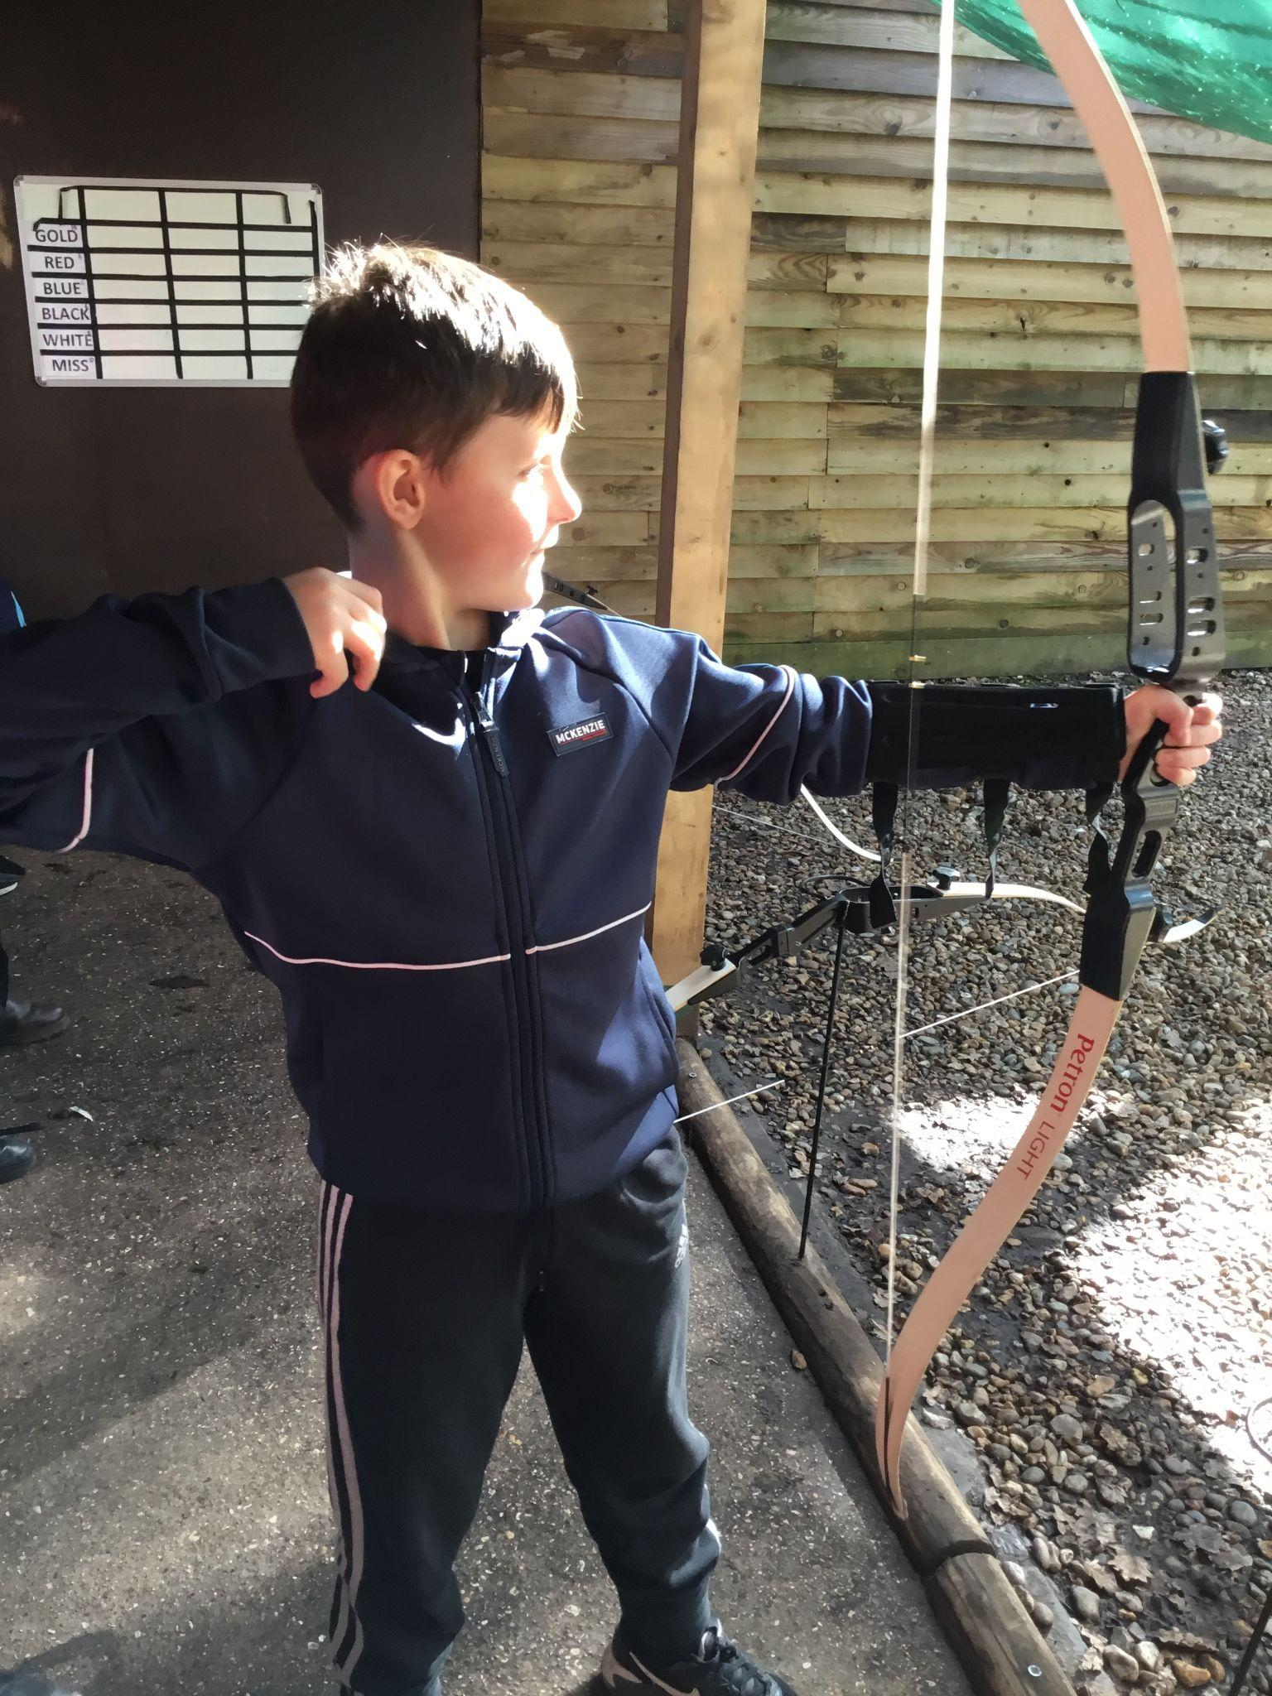
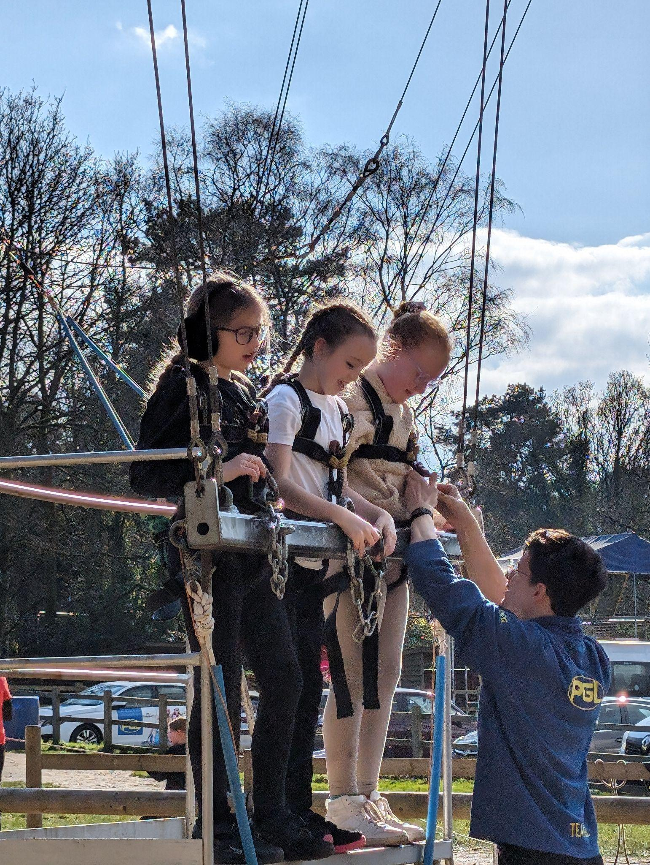
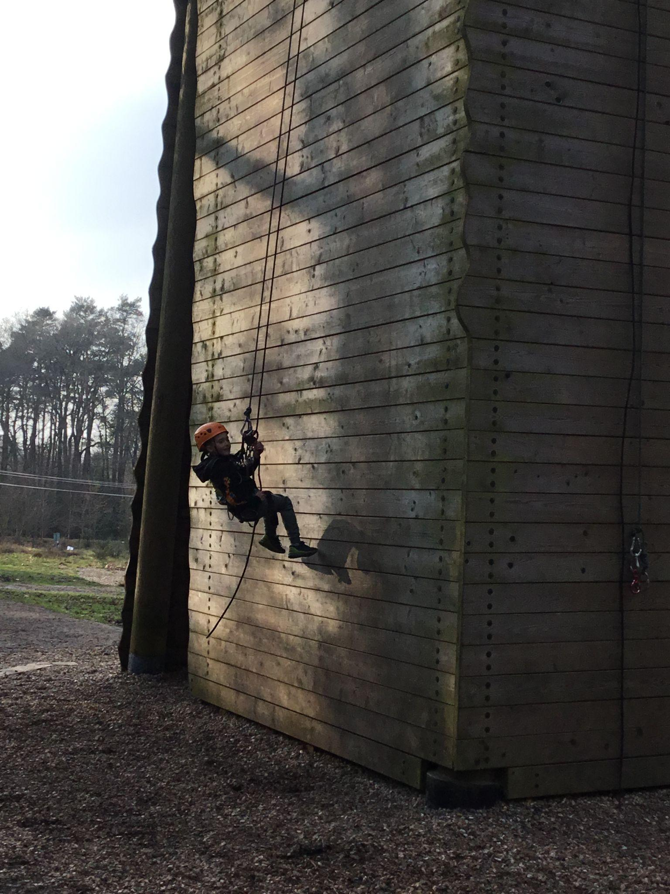
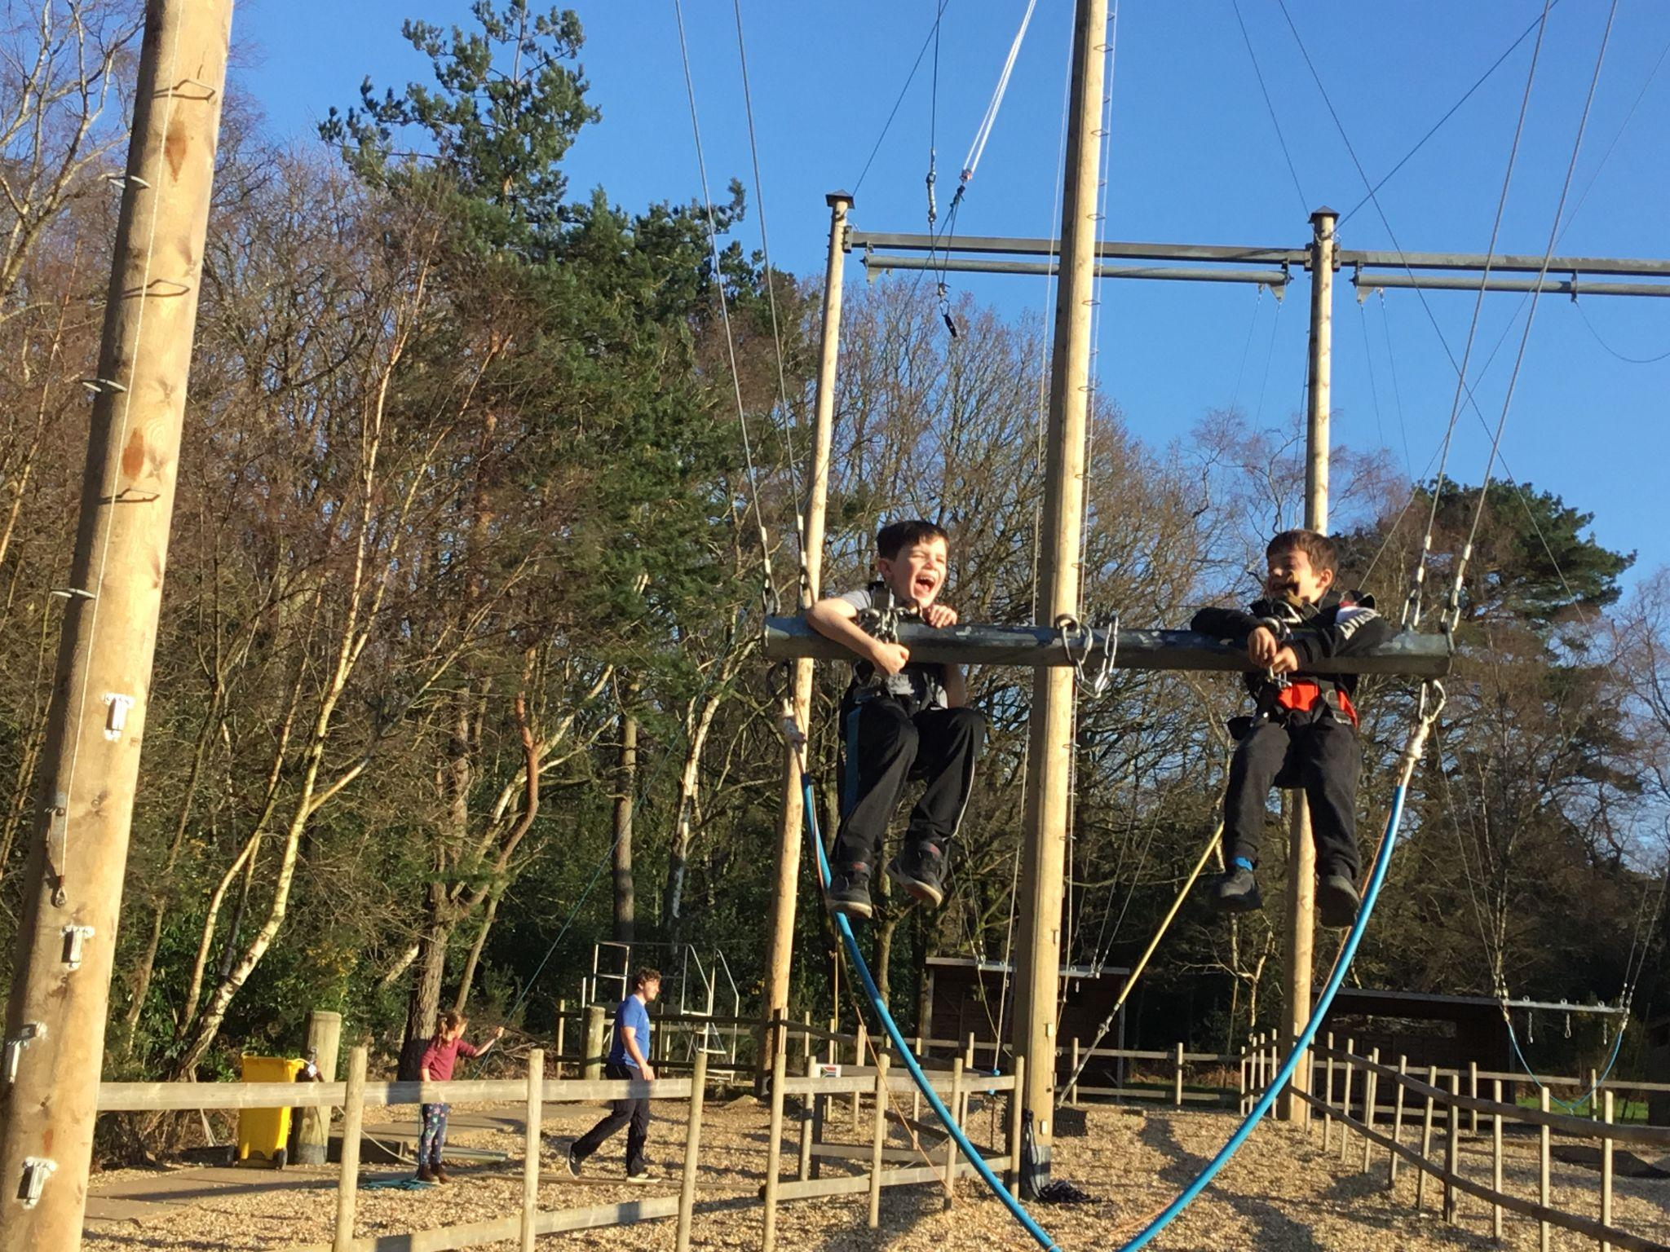
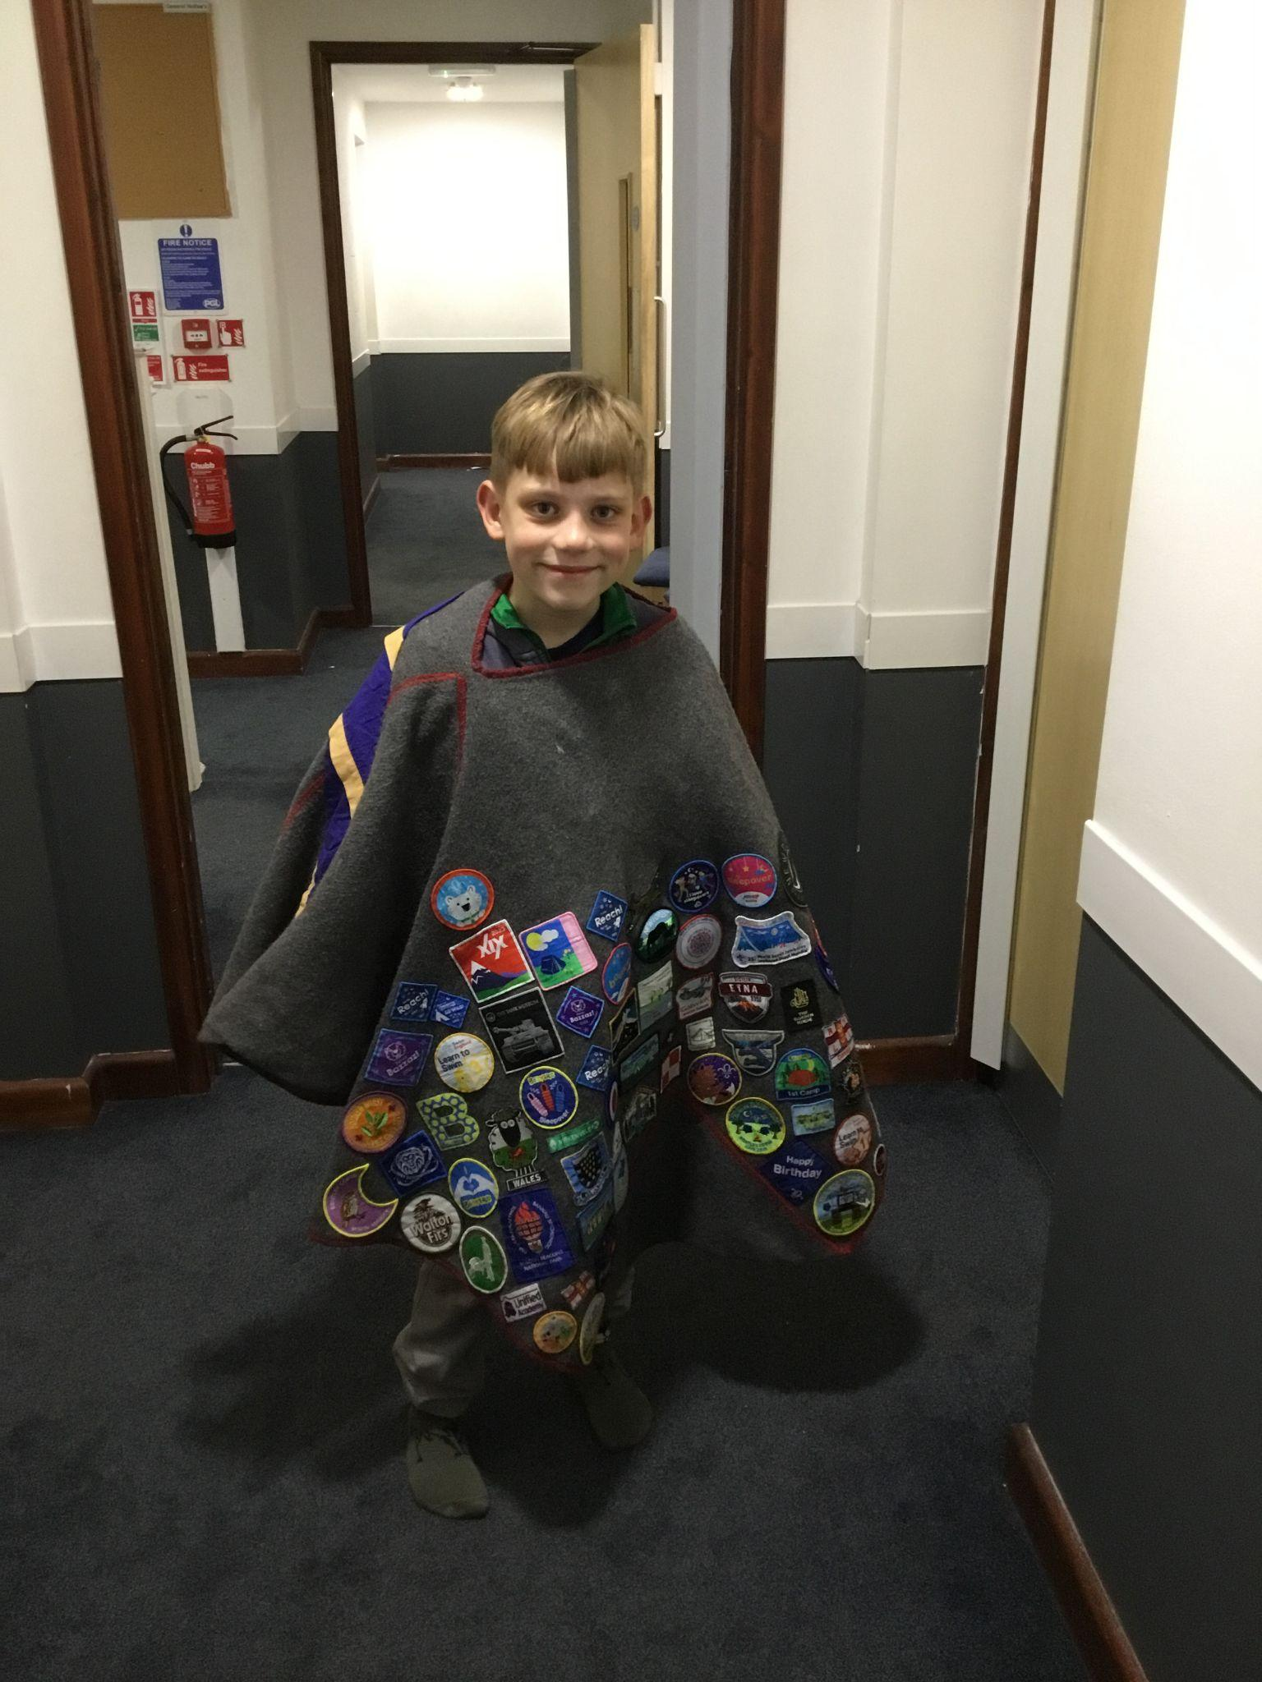
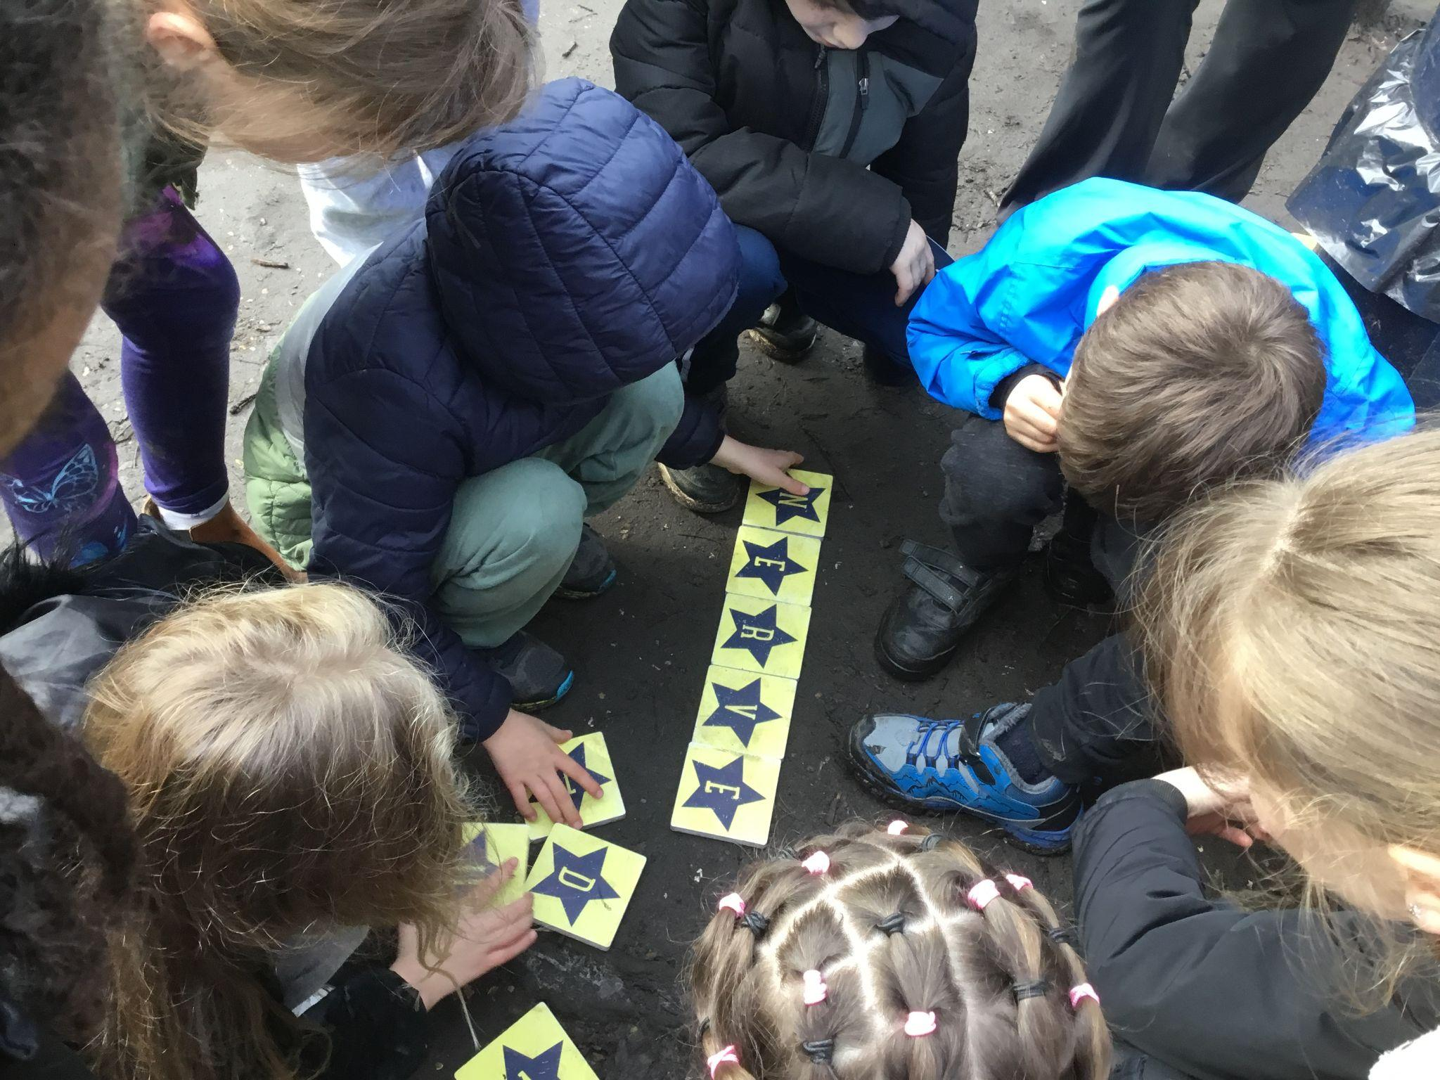
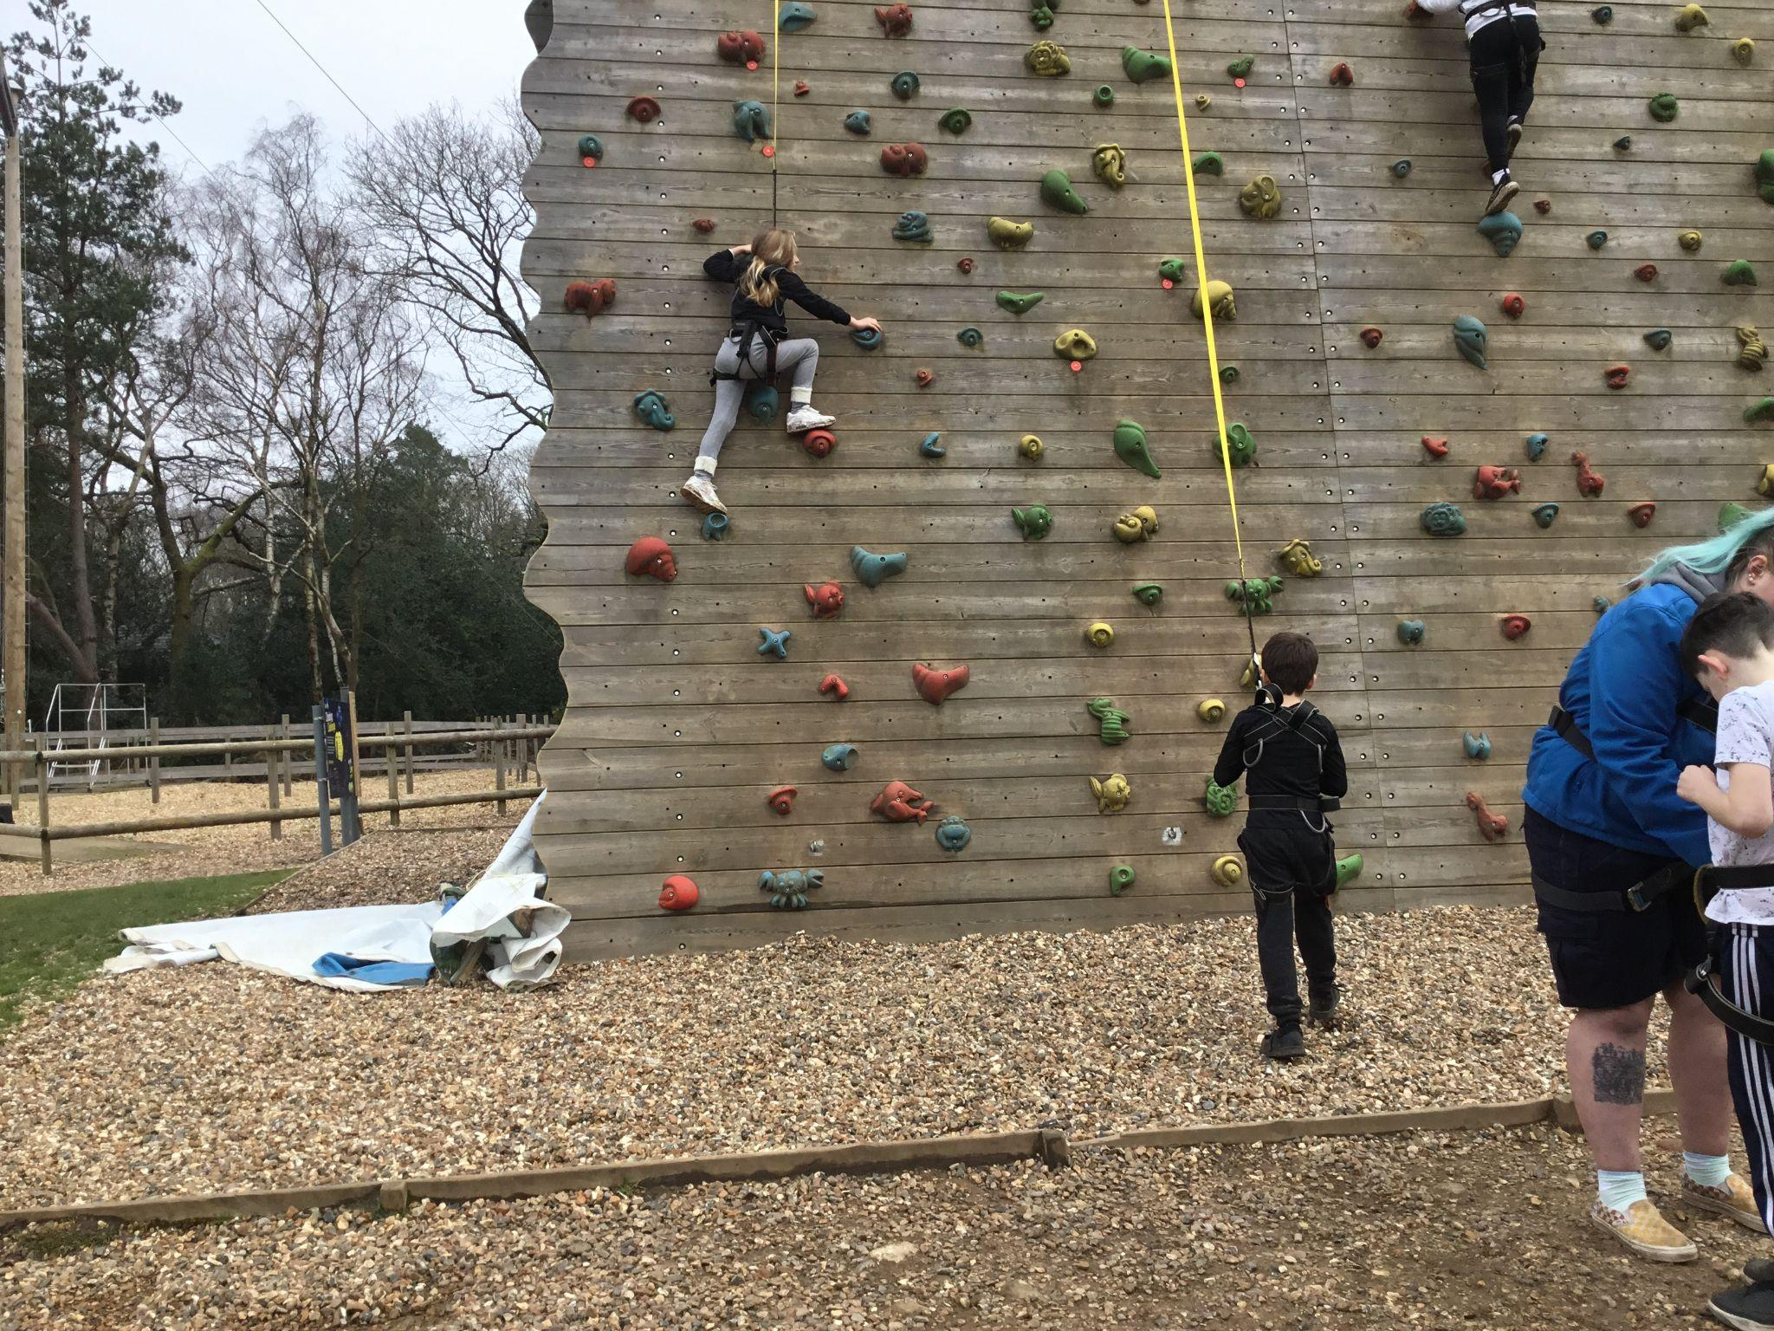
Th
Year 4 had a wonderful at PGL this year (the weather was definitely on our side). We enjoyed a range of activities, from rock climbing to the giant swing, playing hide and seek in the evening and ending our trip with a campfire, singing songs and eating smores. It was wonderful to see all the children giving everything a go and showing true resilience. We even got to have a mini birthday party on the first night. The children showed all our values helping one another with each and every task.
Year 4 Resilience Class
St John's CofE Primary School, Goodwyns Road, Dorking, Surrey, RH4 2LR

Slide 8
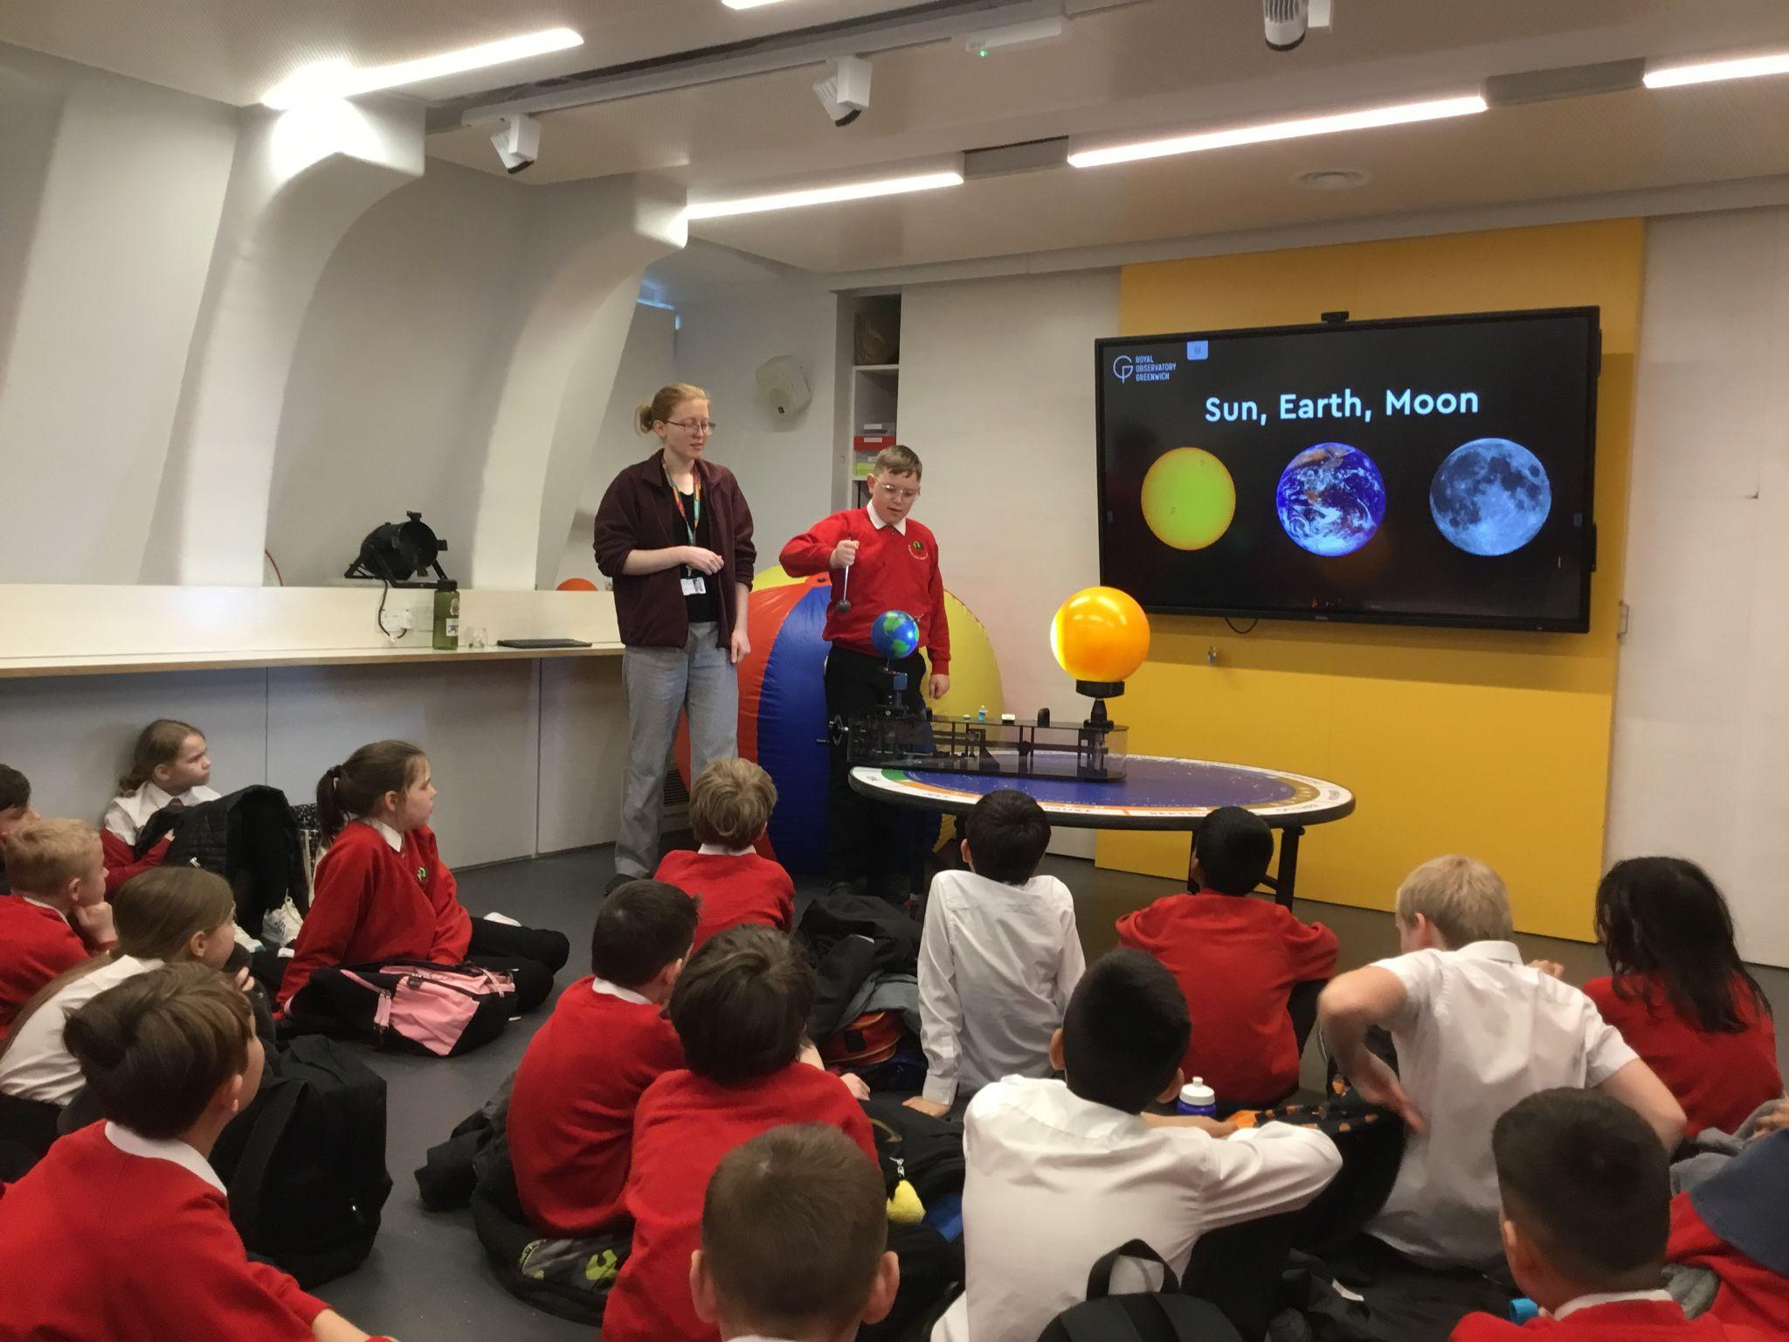
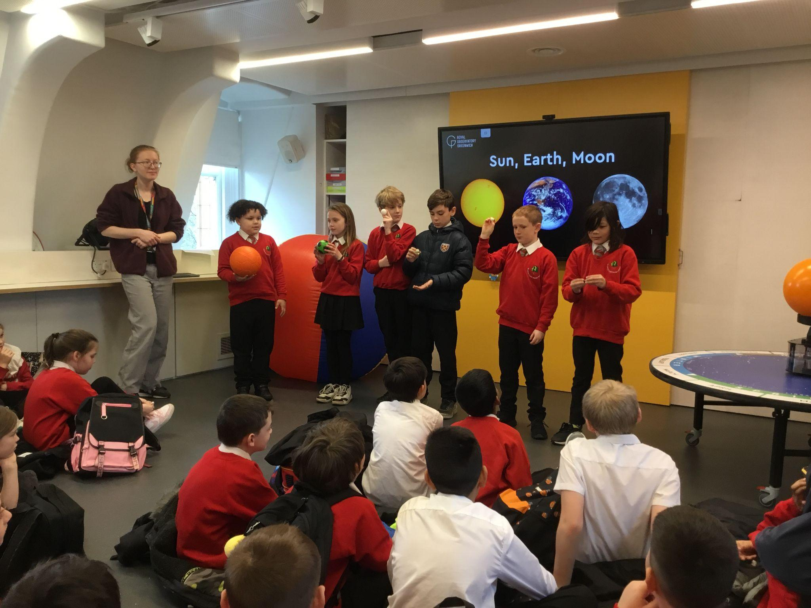
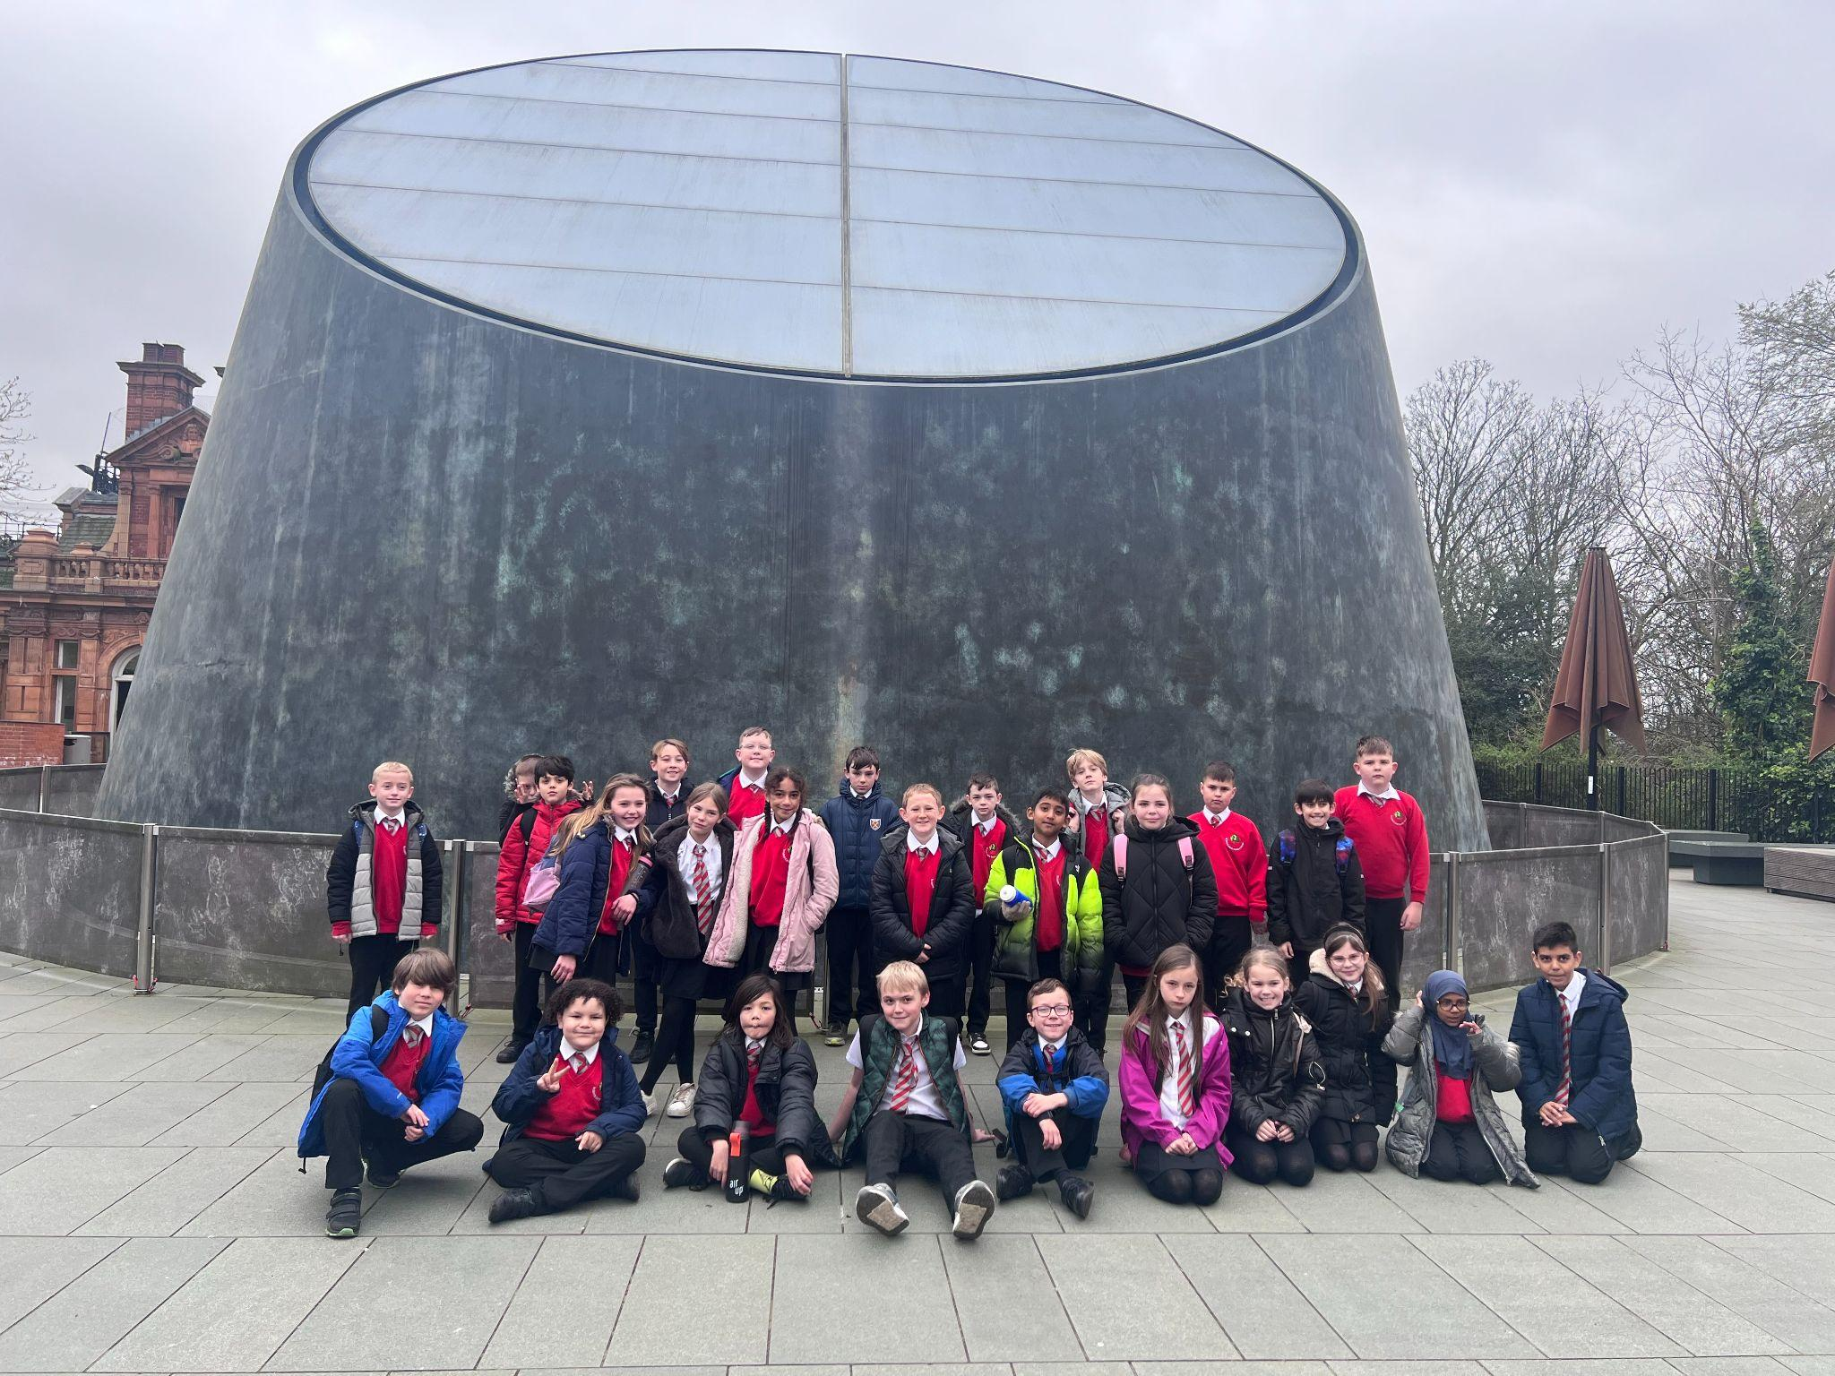
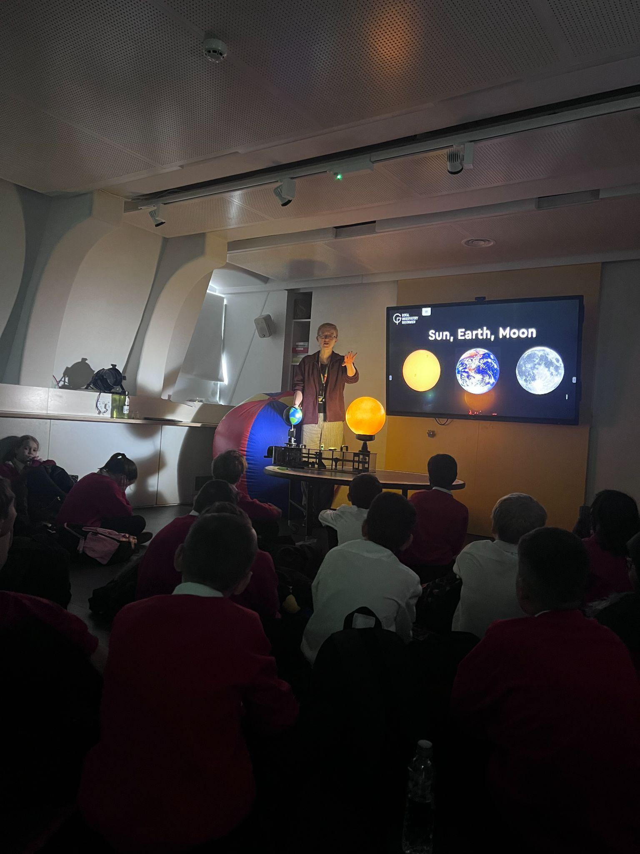
Sud, Dorking, Surrey, RH4 2L
Year 5 Courage Class
During our visit to the Royal Observatory Greenwich the children had an exciting and unique opportunity to explore and immerse themselves in Space exploration. Firstly, the children were able to enjoy the astronomer-led workshops where they had plenty of opportunities to ask questions and discover new things about our universe. The workshops used a combination of sound, film, large scale demonstrations and team activities that explain different scientific concepts. This was followed by a planetarium show that took them on amazing journeys to explore and experience the wonders of the night sky. Combining real images from spacecraft and telescopes with advanced CGI, all projected onto a fully immersive dome, the planetarium will fly children into the heart of the sun, distant galeries, show the birth of a star or even experience landing on Mars. We had the most wonderful time!
St John's CofE Primary School, Goodwyns Road, Dorking, Surrey, RH4 2LR

Slide 9
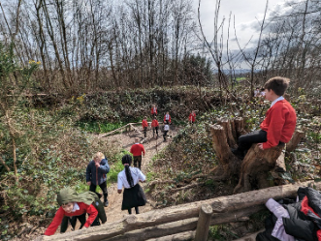
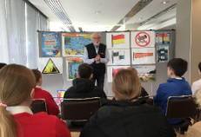
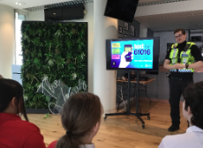
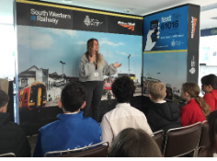
Year 6 Respect Class
Year 6, as part of their learning about World War Two, visited the home of former Prime Minister Sir Winston Churchill. They learnt about the house that Churchill called home and where he brought up his young family. Decorated as it was in the 1930s, the pupils made their way through the rooms like the library, study, sitting room and dining room displayed as if the family had only just left. The children explored the museum rooms filled with gifts that Churchill received and saw the personal possessions that Churchill and his family kept at Chartwell. As they made their way around the house they uncovered the home and family man behind the statesman. The children had a fantastic day and learnt a great deal about the man who was voted ‘Greatest Briton’.
Year 6 were also very fortunate to visit ‘Junior Citizens’ in Epson this half-term. The children were exposed to an innovative and interactive way of delivering health and well-being messages in preparation for their migration to secondary school. The event encouraged model behaviour and good citizenship through active participation in a range of health and safety activities. Professionals from the combined Emergency Services and local agencies were on hand to instruct the pupils on matters that promoted good citizenship, community values and ultimately could help save lives.
St John's CofE Primary School, Goodwyns Road, Dorking, Surrey, RH4 2LR

Slide 10
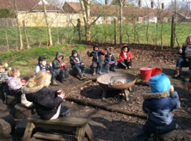
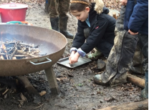
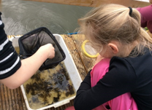
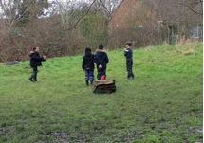
Reception, Year 2 and Year 4 spent time down on the farm leading their own learning.
Games were played to help our younger learners about safety around the campfire and Year 2 learnt about biomimicry as part of their game involving bird survival. Year 4 linked their classroom science work about classification by pond dipping and using keys to identify and group the creatures they found.
Forest School
St John's CofE Primary School, Goodwyns Road, Dorking, Surrey, RH4 2LR

Slide 11
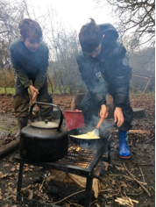
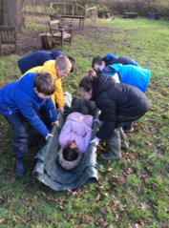
Forest School
Year 5 have been learning new skills during their Forest School sessions including how to make a stretcher and safely move a ‘casualty'!
They met the challenge of independently making pancakes and cooking them over the campfire; planted elder rods, learning that plants don’t just grow from seeds; and practised sawing then painting wooden discs.
St John's CofE Primary School, Goodwyns Road, Dorking, Surrey, RH4 2LR

Slide 12
NHS Who Cares?
Years 5 & 6 enjoyed a show called NHS who cares? It was about the all the wonderful NHS jobs as well as showing what they do for us. At the end the children got to vote on some of the things they have learnt from the show.
St John's CofE Primary School, Goodwyns Road, Dorking, Surrey, RH4 2LR

Slide 13
During Multicultural Book Week, we had a lot of fun enjoying reading, learning about different cultures and producing pieces of writing inspired by a range of authors.
The author, Christian Darkin, came to visit our school and he delivered a great assembly on how he made one of his books. He showed us how he gathered ideas from his family, created animations and wrote for a very long time. Christian answered questions from some of our fascinated children and showed us some of his finished books. Every class then had a workshop with him and thoroughly enjoyed themselves.
We had a ‘surprise reader’ session where every child chose a story they wanted to listen to. The children then visited the classroom where it was being read to enjoy with lots of different children and the surprise reader!
Alfie (Year 5) enjoyed going to our Year 3 classroom to listen to: The Tunnel by Anthony Browne. He said he enjoyed a biscuit too!
As a school, we took on the challenge of writing Molly McDrew’s adventure around the world. Each class had Molly visit a different culture and she flew to some lovely places.
If you haven’t had the chance to read our school adventure story, make sure you do!
https://docs.google.com/presentation/d/16GVeqpLJjIhobKqv10XGWa7u-Aal9pkGYkqvbSKU6NA/edit?usp=sharing
Multicultural Book Week
St John's CofE Primary School, Goodwyns Road, Dorking, Surrey, RH4 2LR

Slide 14
We know it can be difficult to know what to do when it comes to snacks, so we have lots of tips and advice to help you make and buy healthier options.
Fruit and veg snacks are always the best choice, but if the kids are having packaged snacks, just remember to aim for 2 a day max.
Be snack smart and help cut back with these quick and easy ideas.
https://www.nhs.uk/healthier-families/food-facts/healthier-snacks/ have a look here for some great ideas!!
If you are keen to find out more abou healthy lunchboxes, look no further than here:
https://www.nhs.uk/healthier-families/recipes/healthier-lunchboxes/
Be Your Best teach about healthy eating for children, being more active, portion sizes, help to reduce child's weight:
https://www.bybsurrey.org/.
Our Home School Link Worker, Helen, is able to make referrals if you are interested.
Healthy Snacks
St John's CofE Primary School, Goodwyns Road, Dorking, Surrey, RH4 2LR

Slide 15
Online Safety
St John's CofE Primary School, Goodwyns Road, Dorking, Surrey, RH4 2LR

Slide 16
Online Safety
St John's CofE Primary School, Goodwyns Road, Dorking, Surrey, RH4 2LR

Slide 18
St Johns CofE Primary School, Goodwyns Road, Dorking, Surrey, RH4 2LR

Slide 25
Diary Dates 2023/24
March
29th March - 14th April | Easter Holiday
April
15th April | Inset Day
16th April | 9am Reception Bocketts Farm Trip
23rd April | 8:30am Year 4 SES Water Reservoir Trip
May
6th May | Bank Holiday
20th May | 8.30 Year 5 Brooklands Trip
24th May | Mufti Day -£1 contribution to minibuses
27th-31st May | Half Term
June
3rd-7th June | Year 6 Residential-Isle of Wight Trip
12th June | Year 3 Trip Natural History museum Trip
17th June | Squires Trip to dig up potatoes
18th June | Sports Day
26th June | Year 1 British Wildlife Centre Trip
St John's CofE Primary School, Goodwyns Road, Dorking, Surrey, RH4 2LR

Slide 26
Diary Dates 2023/24
June
27th June | Year 2 Godstone Farm Trip
28th June | Mufti Day-Come in dressed as something you would like to be when you are older
July
2nd July | Move Up Day
5th July | Summer Fair
7th July | Mufti Day- £1 contribution to the minbuses
12th July | Year 6 Performance and Awards Ceremony
15th July | Year 6 Leavers Service
16th July | Last Day of Term for Nursery
17th July | End of Term Mufti Day- £1 Contribution towards minibus
18th-19th July | Inset Days
20th July-31st August | Summer Holidays
September
9th September | Individual School Photos
St John's CofE Primary School, Goodwyns Road, Dorking, Surrey, RH4 2LR

